Slide 1
Training
Ideas for supporting ITALL Materials & Training

Slide 2
Aims
To enable participants to become effective tutor assistants of adult
literacies using a lifelong learning approach.
Ask participants what their aims are.

Slide 3
Outcomes
By the end of the training participants should:
have an understanding of the principles of adult literacies in Scotland
appreciate what is required for effective adult tutoring
understand that literacies are complex capabilities
be aware of a variety of strategies of teaching literacies
understand that assessment, guidance and record keeping are essential elements in literacies programmes

Slide 4
Definitions
Formal education
The progressively structured, age-graded ‘education system’ beginning with primary schools and running through to further and higher education institutions. The term covers technical and professional training as well as more general academic studies.

Slide 5
Definitions
Informal adult learning
The lifelong process whereby every adult develops new knowledge, skills, understandings and attitudes in the course of daily experience. Each person learns spontaneously in response to the influences and resources in his or her environment – from work colleagues and friends, from family and neighbours, as well as from wider sources such as mass media.

Slide 6
Definitions
Non-formal adult learning
Adult learning that does not follow the requirements often associated with formal education: for example, a set curriculum, formal assessment or accreditation. In non-formal adult learning, learning is negotiated to meet individual needs (often in the context of a group). Learning is focused on the goals and interests of the learner(s).

Slide 7
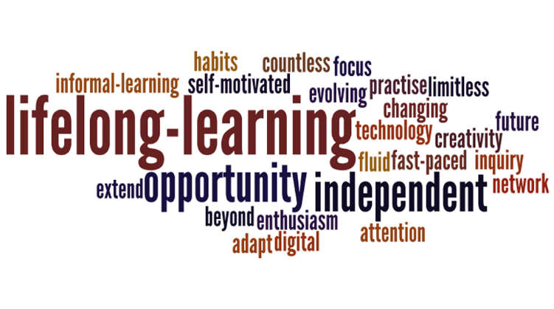
Lifelong learning
Lifelong learning is the practice of continuing to learn throughout people’s entire life, especially outside of or after the completion of formal schooling.
Within the adult learning sector, before starting tuition, adult learners are seen in terms of the complex skills and knowledge they already have.
Nationally and globally it is widely acknowledged that adult learning (consisting of informal and non-formal) enhances: social inclusion, active citizenship, personal development, self-sustainability, as well as competitiveness and employability.

Slide 8
Literacies - Definition
“The term ‘literacies’ is used to encompass not only the skills, but also the
knowledge and critical understanding involved in using numbers, reading,
writing, listening and talking. The plural term reflects the multiple and
diverse ways in which we use literacy and numeracy in our everyday
lives; in other words, the complex literacy and numeracy capabilities
(‘literacies’) one person uses will differ from another’s.”
2016: Education Scotland: Scotland’s Adult Literacies Curriculum
Framework Guidelines: learning, teaching and assessment

Slide 9
Timetable of Development of Adult Literacies in Scotland since 2001
Over the last couple of decades, there have been significant development
in Scotland, detailed in some of these key reports:
2001: Scottish Executive’s Adult Literacy & Numeracy in Scotland Report
(ALNIS)
www.scotland.gov.uk
This report made 21 recommendations for building a world-class adult
literacy and numeracy service for Scotland. Central to its’ vision was a
learner-centred, social practice approach.

Slide 10
Timetable of Development of Adult Literacies in Scotland
2004 - ‘An Adult Literacy and Numeracy Curriculum Framework for
Scotland’
www.scotland.gov.uk
Its underpinning principles sought to embed in Scottish adult literacies
practice:
an understanding of literacy and numeracy as critical social practices and complex capabilities;
the positioning of the learner as central to their learning;
the importance of individually negotiated and planned learning that focused on the application of learned skills, knowledge and understanding.

Slide 11
Timetable of Development of Adult Literacies in Scotland
2010: Scottish Government’s Literacy Action Plan
www.scotland.gov.uk
This established Scotland’s overarching vision for all learners – to raise
standards of literacy for all from the early years through to adulthood. Its’
aim was to promote equal access to and participation in literacies learning
for all adults.

Slide 12
Timetable of Development of Adult Literacies in Scotland
In 2010 the Scottish Government launched a refreshed strategy for adult
literacies:
2010: Scottish Government’s Adult Literacies in Scotland 2020:
Strategic Guidance
www.scotland.gov.uk
“By 2020 Scotland’s society and economy will be stronger because
more of its adults are able to read, write and use numbers
effectively in order to handle information, communicate with
others, express ideas and opinions, make decisions and solve
problems, as family members, workers, citizens and lifelong
learners.”

Slide 13
Timetable of Development of Adult Literacies in Scotland
The report’s four overarching outcomes were:
improved access to literacies learning opportunities
high quality learning and teaching
improved infrastructure
evidence of impact
“This document aims to promote equal access to and participation in
literacies learning for all adults. It is intended to promote equality of
opportunity to those who face persistent disadvantage and to increase
the numbers of people economically active across all groups within
society.”

Slide 14
Timetable of Development of Adult Literacies in Scotland
This publication identified 4 key themes:
Literacies for employment and work
Literacies and financial capability
Literacies and families, and
Literacies and health and wellbeing

Slide 15
Timetable of Development of Adult Literacies in Scotland
2014: Scottish Government’s Adult Learning in Scotland
- Statement of Ambition
www.scotland.gov.uk
This reflected a continuing commitment to ‘learner-centred,
life-wide, lifelong-learning'.
Education Scotland: A professional development framework for
Scotland’s adult literacies workforce
https://education.gov.scot/Documents
Outcome 2: Adult literacies learners receive high quality learning
and teaching so they can achieve their goals.

Slide 16
Timetable of Development of Adult Literacies in Scotland
Scotland’s Adult ESOL Strategy 2015-2020
The Adult ESOL Strategy for Adults in Scotland re-affirmed the Scottish government’s vision: to provide high quality English language provision to enable participation and integration in Scottish life through work, study, family and local community. As with Adult Learning In Scotland – Statement of Ambition, this strategy was also informed by the principles of lifelong, life-wide, learner-centred learning.

Slide 17
Timetable of Development of Adult Literacies in Scotland
2016: Education Scotland: Scotland’s Adult Literacies Curriculum
Framework Guidelines: learning, teaching and assessment
www.educationscotland.gov.uk/communitylearninganddevelopment/.
Literacies
“The term ‘literacies’ is used to encompass not only the skills, but also the
knowledge and critical understanding involved in using numbers, reading,
writing, listening and talking. The plural term reflects the multiple and
diverse ways in which we use literacy and numeracy in our everyday
lives; in other words, the complex literacy and numeracy capabilities
(‘literacies’) one person uses will differ from another’s.”

Slide 18
Development of Adult Literacies in Scotland
2021: Adult Learning Strategy for Scotland
The Scottish Government is currently working with its partners to develop
a new Adult Learning Strategy for Scotland. (The principles of the
‘Statement of Ambition for Adult Learning’ should underpin the adult
learning strategy.)

Slide 19
Global Context
The UNESCO Institute for Lifelong Learning (UIL) undertakes research, capacity-building, networking and publication on lifelong learning with a focus on adult and continuing education, literacy and non-formal education.
‘Inclusive education is fundamental to the achievement of human, social and economic development. Equipping all individuals to develop their potential contributes significantly to encouraging them to live together in harmony and with dignity. There can be no exclusion arising from age, gender, ethnicity, migrant status, language, religion, disability, rurality, sexual identity or orientation, poverty, displacement or imprisonment. Combating the cumulative effects of multiple disadvantage is of particular importance.’
Source: UIL, 2010, p. 873 PART 1 PARTICIPATION, INCLUSION AND EQUITY

Slide 20
Global Context
Global Reports - GRALE
The Global Report on Adult Learning and Education (GRALE) provides a clear and comprehensive picture of the state of adult learning and education (ALE) around the world. Four reports have been published since 2009. The next GRALE will be published in 2022.
The UNESCO Third Global Report on Adult Learning and Education (GRALE) looks at the overlapping benefits of adult learning and education (ALE) in three areas - health and wellbeing; social, civic and community life and employment and the labour market.
Image: Adult Learning and Education (ALE) Benefits
https://uil.unesco.org/adult-education/global-report

Slide 21
Global Context

Slide 22
Global Context
ALE AND THE 2030 AGENDA FOR SUSTAINABLE DEVELOPMENT
Both the 2030 Agenda for Sustainable Development and the Education 2030 Framework for Action identify the role of ALE in contributing to progress. The Education 2030 Incheon Declaration is subtitled ‘Towards inclusive and quality education and lifelong learning for all’, recognizing that education and learning continue throughout (and across) the life course.

Slide 23
Principles underpinning adult literacies practice
Scottish adult literacies practice involves:
the design of provision;
planning and reviewing individual and group learning;
learning and teaching activities;
assessment and evaluation;
support and guidance

Slide 24
Principles underpinning adult literacies practice
The Scottish approach to adult literacies practice is underpinned by a number
of principles. These five principles are set out below, and they should underpin
all aspects of adult literacies practice:
1. The learner is at the centre of their learning, and progress in learning is planned and paced appropriately to their needs and wants.
2. The social practice approach is the most effective way to build the literacies capabilities of individuals and communities.
3. Literacies are not a set of prescribed skills to be acquired, but should be seen as complex, critical capabilities that are fit to meet the needs of the modern, changing literacies capabilities of individuals and communities.
4. Numeracy learning opportunities are as important as literacy learning opportunities and should be available to all learners in all learning provision.
5. Literacies learning should be inclusive and empowering.

Slide 25
Timetable of Development of Adult Literacies in Scotland
The social practice approach
Adult literacies learning and teaching in Scotland uses a ‘social practice’ approach, which recognises that the development of literacies depends on the contexts and activities in which learning occurs, the purposes of the learning, and the cultural patterns that are valued in communities and broader society. Adults will learn most effectively what they want or need to learn, and so the emphasis for the learning should be on the uses and application of literacies learning.

Slide 26
Timetable of Development of Adult Literacies in Scotland
The social practice approach has at its heart the principle that literacies
learning has complex relationships to social, emotional and personal
values and practices. Learning programmes should focus on the skills,
knowledge and understanding that enable learners to deal more
effectively and critically with their real life concerns - in the family, with
friends, at work, and in the local community and wider society. Learning
programmes value and build on the knowledge and experience adults
bring to their learning. Individual and group learning plans promote
learner control and ownership of learning, and enable recognition of
progress through the distance learners travel towards their own goals.

Slide 27
The Social Practice Approach
It is widely regarded as an approach which responds to learner’s goals and aspirations and one which is most likely to leave a lasting positive impact on learners.
The social practices approach is one which –
Recognises, values and validates the range of experiences and skills that people bring to any learning
Starts from people’s strengths and aspirations, not their weaknesses, or perceived ‘needs’
Recognises and builds on the ways that people learn
Provide learning that develops from, and is embedded in, contexts which are relevant to the learner

Slide 28
The Social Practice Approach
Recognises the different values, emotions and perspectives that are embedded in learning
Is open about the power dimensions of learning and enable learners to exercise power themselves
Develops learner’s critical capacities
Develops learner’s abilities to use their learning in other contexts.
…is geared to the learner’s goals and aspirations.

Slide 29
The adult literacies learning cycle

Slide 30
Barriers to learning - Activity
Activity:
Note down a few of the barriers some learners experience when
trying to participate in adult learning.
What can be done to overcome these barriers?
Note down some of the benefits of adult learning.

Slide 31
Barriers to learning
The barriers to learning experienced by adults are multi-layered and
interrelated:
Cost of learning
Fear of learning
Lack of confidence
Family commitments

Slide 32
Overcoming barriers to learning
Adults are motivated to learn if the potential outcomes are clear and valued.
Evidence on the positive outcomes and potential impact of learning as an adult should be widely communicated.
Raising the perceived value of learning could help to overcome associated barriers.
Information about learning opportunities can be shared and communicated proactively in a variety of ways, including the internet and in public spaces.
Many adults experience competing priorities such as work, family and caring responsibilities. Learning provision should accommodate this and offer flexibility, for example outside of working hours, online and/or blended learning.
‘Barriers to learning for disadvantaged groups’, Department for Education, 2018
www.gov.uk/government/publications
See also: ‘Identifying and reducing barriers to participation in adult literacy and numeracy tuition’, 2010, NALA.
www.nala.ie/research/literacy-numeracy-participation-reducing-barriers-to-learning

Slide 33
Overcoming barriers to learning
The perceived benefits of learning are complex and wide-ranging, e.g.:
Confidence
Health
Well-being
Social relationships
Improved work prospects
Possible career progression

Slide 34
An Inclusive Approach
An inclusive approach says that all adults have a right to access appropriate
education.
Many adults are excluded because of:
Low income
Transport difficulties
Dyslexia
Health problems
English being a second language
Learning disabilities
Mental health issues

Slide 35
An Inclusive Approach
Mental health issues
Shift working
Child-care issues
Access issues
Sensory difficulties
Lack of support outside the classroom
Obstruction by family
Past negative experience of learning
Peer pressure

Slide 36
Specific learning difficulties
Specific learning difficulties are a range of neuro-developmental conditions
that affect the individual’s abilities to learn in everyday contexts by
traditional methods.
These conditions are distinct from global learning difficulties in that
difficulties arise not from intellectual impairment but rather from particular
processing differences and, typically, there will be a discrepancy between
the individual’s general cognitive abilities and their abilities in certain areas
of learning (such as written language or number skills) or under certain
circumstances.

Slide 37
Specific learning difficulties
Many people have difficulties in fully grasping the skills of efficient
reading, writing and using numbers because of a specific learning
difficulty such as dyslexia, dyscalculia, and dysppraxia, or a number of
linked conditions.
However, their difficulties (with literacies) may go unrecognised
in day-to day life because they are otherwise very capable, intellectually
able and articulate.

Slide 38
Specific learning difficulties
Very often, people with specific learning difficulties can cope reasonably
well with literacies tasks in ideal situations, but in other
circumstances, time pressure, stress, fatigue or even environmental
factors, such as lighting, noise or unfamiliar settings, can seriously impair
their abilities.

Slide 39
Neurodiversity

Slide 40
Dyslexia
Quiz
True or False?
Dyslexia is all about reading and spelling difficulties.
The incidence of dyslexia is higher amongst males.
Not many people are dyslexic.
Only ‘clever’ people have dyslexia.
Dyslexia is a sign of low intelligence.
Dyslexia cannot be a disability.
Specialist support teachers are the only teachers who should provide appropriate support, planning and monitoring of dyslexic learners.

Slide 41
Dyslexia
What is dyslexia?
It is estimated that 1 in 10 people has dyslexia.
Dyslexia exists in all cultures and across the range of abilities and backgrounds.
Dyslexia often runs in the family.
There is no ‘cure’ but lots of practical things can help overcome some of the barriers it presents.
Dyslexia is a learning ‘difference’, which means that the brain can approach things in a different way to other people.
Dyslexia can affect the way people communicate, and is different for everyone.
It is not just about reading and writing and it has nothing to do with intelligence.

Slide 42
Dyslexia
Dyslexia is classed as a disability under the Equality Act.
It is important to remember that everyone with dyslexia is different.
Everyone has different strengths, difficulties and strategies that work for them
The impact of dyslexia as a barrier to learning varies in degree according to the learning and working environment.
‘What is dyslexia?’ www.dyslexiascotland.org.uk/our-leaflets

Slide 43
Dyslexia
In 2009, the Scottish Government, Dyslexia Scotland and the Cross Party
Group on Dyslexia in the Scottish Parliament agreed a working a definition
of dyslexia:
“Dyslexia can be described as a continuum of difficulties in learning to read, write and/or spell, which persist despite the provision of appropriate learning opportunities. These difficulties often do not reflect an individual’s cognitive abilities and may not be typical of performance in other areas. The impact of dyslexia as a barrier to learning varies in degree according to the learning and teaching environment, as there are often associated difficulties”. (The full definition is available on Dyslexia Scotland’s website).
See Dyslexia Scotland leaflet: “What is Dyslexia?”
www.dyslexiascotland.org.uk/our-leaflets

Slide 44
Dyslexia

Slide 45
Dyslexia
Dictation Exercise
Trainer reads out a paragraph of text and asks the participant to listen and copy it down with their non-dominant hand (i.e. if they are left-handed, write with their right hand.
“What would you say if I told you that recruiting an extra 5% to your
workforce, who have the skills you need, could double your productivity and
give you a lasting competitive advantage? What would you say if I told you
that you already have these people) working for you, and all you need to do
is get them onto your talent management programme so they can further
refine the necessary skills?”
(Prof R. Nicholson in his iBook, ‘Positive Dyslexia’)

Slide 46
Dyslexia
Reflection on dictation exercise:
How did that exercise make you feel?
If you experienced this all day every day, how would it affect you and your work and learning?
How do you think other people may view you?
What do you think of the message in the dictation?

Slide 47
Dyslexia

Slide 48
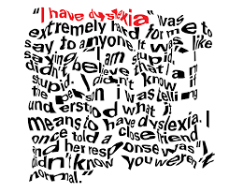
Dyslexia
Visual Stress
YouTube video:
‘Visual Dyslexia Explained – how text
appears with Scotopic Sensitivity’
(dyslexia) (full version)
www.youtube.com/watch?v=wcjEwtseP7o

Slide 49
Dyslexia-Friendly Formats
When producing documents and worksheets, it is important to focus on the
presentation and layout to ensure that information is easily accessible.
Ask the learner what works for them.
Use fonts which are clear, rounded and have a space between letters, such
as:
Century Gothic
Comic Sans
Arial
Verdana
Tahoma
Use text at font size 12 or above.

Slide 50
Dyslexia-Friendly Formats
Use pastel shades of paper (cream is a good alternative to white).
Matt paper reduces ‘glare’.
Avoid black text on a white background and light text on a dark background.
Use 1.5 or double line spacing.
Use left-aligned text.
Use wide margins.
Use lower case rather than capital letters.
Use numbers or bullet points rather than continuous prose.

Slide 51
Dyslexia-Friendly Formats
Sentences and written instructions should be short and simple.
Keep paragraphs short – dense blocks of text are difficult to read.
Avoid too much text on the page. Make sure that it isn’t too cluttered.
Avoid the use of background graphics with text over the top.
Use text boxes or borders for headings or to highlight important text
Avoid underlining and italics which can make words ‘run together’.
Use bold text for titles, sub-headings or to draw attention to important information or key vocabulary.
Colour-code text – for example, information in one colour, questions in another.
www.dyslexiascotland.org.uk/our-leaflets

Slide 52
Dyslexia
Dyslexia Scotland – Adult Masterclasses –
YouTube videos
Part 1: What is Dyslexia?
https://www.youtube.com/watch?v=sSpM-QR44bs&t=3s
Part 2: Working and Studying with Dyslexia’
https://www.youtube.com/watch?v=QzuEGsCMxBU&t=92s
Part 3: ‘Dyslexia and Emotions’
https://www.youtube.com/watch?v=1W9spGB88ec&list=PL0wuerC08SwsvXB8lA4WN_5EijX5wcHb1&index=9&t=60s

Slide 53
Health Literacy

Slide 54
Health Literacy
Health literacy concerns how people engage with services that are
essential to their physical, mental and psychological health and wellbeing. This
is facilitated through:
Health services communicating clearly and taking account of possible health literacy and numeracy needs
People understanding health information correctly and making informed decisions.
“Health literacy is the degree to which individuals have the capacity to
obtain, process, and understand basic health information and services
needed to make appropriate health decisions.”
(‘Healthy People’, 2020). www.cdc.gov/nchs/healthy_people/hp2020.htm

Slide 55
Health Literacy
Health Literacy is being increasingly recognised as a significant public health
concern around the world. The World Health Organization (WHO) set
improving health literacy as a global priority for healthcare, disease
prevention and health promotion at its 2016 Global Conference.
UNESCO (2016) argues that adult learning and education results in
improving health behaviours and attitudes:
“People with more education are more likely to have a greater understanding of health conditions, better knowledge of the available treatments and more skills to manage their health. Learning leads to greater confidence and self-efficacy, which translates to a greater ability to manage our own lives and health.”

Slide 56
Health Literacy
The Scottish government have published two action plans focused on improving people’s health knowledge and understanding:
‘Making it easy the National Health Literacy Action Plan for Scotland’,(2014),Scottish Government
www.gov.scot/publications/making-easy
‘Making it Easier A Health Literacy Action Plan for Scotland’ 2017-2025 Scottish Government
www.gov.scot/publications/making-easier
See also: A National Health Literacy Resource for Scotland:
“The Health Literacy Place” www.healthliteracyplace.org.uk

Slide 57
Learning Styles

Slide 58
Learning Styles - Activity
Kolb’s Learning Style Questionnaire
www.bunbury.wa.gov.au/pdf/environment/u472/Appendix 19 U472
This questionnaire is designed to find out your preferred learning styles(s) as
an adult.
Are you an activist/theorist/reflector/pragmatist?

Slide 59
Health Literacy - Activity
Å bygge helsekompetanse gjennom muliggør og forståelse i en tid da 4av
10 irere har begrenset helsekompetanse.
What does this mean?
Can you understand it?
How does it make you feel?

Slide 60
Health Literacy
Translation from Norwegian:
Building health literacy through empowerment and
understanding at a time when 4 in 10 Irish people have
limited health literacy. (NALA, Ireland 2020)

Slide 61
Health Literacy
Who is affected?
People most likely to experience low health literacy:
Older adults
Ethnic minorities
People with low levels of formal education
People with low income levels.
(Nielson-Bohlman et al., 2004)

Slide 62
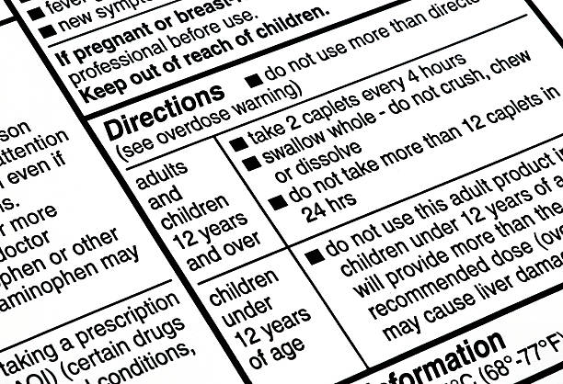
Health Literacy - medication labels
Would someone with literacy difficulties be able to read these labels?

Slide 63
Health Literacy in a Pandemic
The World Health Organisation highlights poor health literacy as an
underestimated health problem globally:
“We are not just fighting an epidemic, we’re fighting an infodemic”.

Slide 64
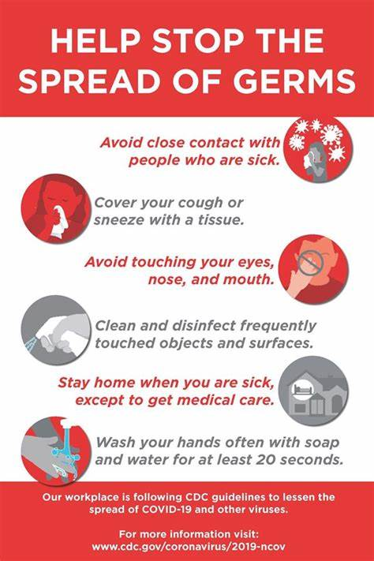
Health Literacy

Slide 65
Health Literacy - Activity
Communication regarding Coronavirus
Research some of the public health messaging/broadcasting round Coronavirus and consider the different ways Government/NHS/official bodies/others did that...e.g. - Public Health TV adverts/text messages/posters/news programmes/newspaper adverts/social media/ ‘easy read’ publications, etc.
Who was their target audience?
What was most effective?
What was their purpose?
Were there any barriers?
Are there ways to overcome these?

Slide 66
Health Literacy
Elspeth Murray’s poem “This is Bad Enough” underscores the importance of taking health literacy demands into account when communicating health information or interacting with patients in a healthcare setting.
A Plea for Clarity
https://www.youtube.com/watch?v=R3tJ-MXqPmk

Slide 67
Critical literacy and media
Critical literacy skills and media literacy are increasingly significant.
Media literacy involves the ability to engage critically with different media sources, and to help people tell the difference between reliable and accurate information and or deliberately false or misleading information.
Critical literacy is much more than reading and writing.
False information/Fake News
Learners need to be supported to be able to distinguish between fact and fiction.
It also has political implications because it affects how people participate in society.

Slide 68
Literacies in the Covid-19 crisis and beyond
During the Covid-19 pandemic, many people struggled with understanding and accessing information, including key messages about public health information and employment supports.
For those with unmet literacy, numeracy and digital skills needs, it was especially challenging.
It is widely acknowledged that Covid-19 has impacted most on workers who have experience of educational and wider inequalities resulting in a lack of educational qualifications.
Further highlighting literacy inequalities many parents who themselves struggled unmet literacy needs and without access to technology resources or digital skills, struggles with supporting their children’s learning during lockdown.

Slide 69
Literacies in the Covid-19 crisis and beyond
These inequalities were further compounded by the closing of regular supports, leaving many adults isolated during this time.
This pandemic has shed a light on the pivotal importance of strong literacy, numeracy and digital skills.
We are living in an information age that requires understanding of how to access and understand health messages and government information about changing behaviour to keep us safe.
We are accessing more services over the phone and online and using critical thinking skills to combat misinformation and lies.

Slide 70
Family Literacy
The key message from Education Scotland and the Scottish Government’s Review of Family Learning (2016) is that family learning, as an early intervention and prevention approach, works in reaching disadvantaged families and communities to improve their life chances. The 2018 National Improvement Framework and Improvement Plan for Scottish Education: Achieving Excellence and Equity, also identifies family learning as a key driver for change.
What is family learning?
Family Learning encourages family members to learn together as and within a family, with a focus on intergenerational learning. Family learning activities can also be specifically designed to enable parents to learn how to support their children’s learning. Family learning is an approach to engaging families in learning outcomes that have an impact on the whole family.

Slide 71
Family literacy
Family literacy is about the way families use and develop literacy and
numeracy skills together in the home.
When parents are involved in their child’s learning, it positively affects the child’s performance at school. Important examples of family literacy include reading a book at bedtime, singing, playing word games, and using a calendar.
Some family literacy initiatives work on supporting a parents’ own unmet literacy and numeracy needs.

Slide 72
Family Literacy
Further Information Information and help is available for practitioners
working with families on our websites and the National Improvement HUB
below:
https://education.gov.scot/improvement
https://education.gov.scot/improvement/learning-resources/engaging-parentsand-families-a-toolkit-for-practitioners
https://education.gov.scot/parentzone

Slide 73
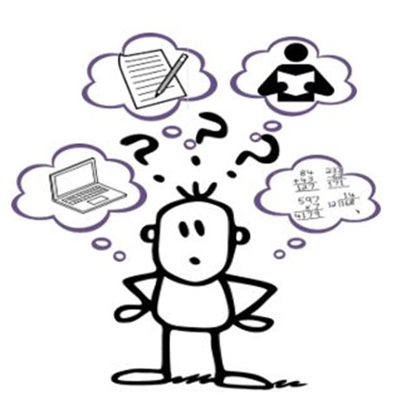
Western Isles Learning Shop

Slide 74
Learning Shop
The Western Isles Learning Shop is an adult literacies centre run by the
Adult Learning and Employability section of the Education, Children &
Skills department.
The Western Isles Learning Shop provides a relaxed and friendly
environment for adults looking to:
restart or further their learning
gain qualifications
learn new skills
learn English

Slide 75
Learning Shop
Learning can take place in various settings:
in small groups
one-to-one tutoring
self-directed with tutor support
Learning support is confidential, free of charge and available to all.
Learners can reclaim travel costs.

Slide 76
Learning Shop
Staff at The Learning Shop Can Help:
adults with basic reading, writing, maths and computing skills
support adults with learning difficulties to use literacies
to boost confidence in literacies and improve prospects in jobs and further education
Current Learning Groups Include:
Reading and Writing – help with basic literacy skills
Lifeskills – help with basic literacy, numeracy and social skills
Help with the Driving Theory test
SQA – Communication and Numeracy courses at SQA levels 3 and 4
ESOL (English for Speakers of Other Languages)
Gaelic Homework support

Slide 77
Learning Shop
Opening Times
Monday to Friday, 9am- 5pm
Contact Details
Western Isles Learning Shop Unit 5 and 6
First Floor 7 James Street Stornoway Isle of Lewis HS1 2QN
Tel: 01851 822718 or 07824 606 927
e-mail: learningshop@gnes.net

Slide 78
Using digital technologies to support adult literacies learning
Research shows that digital technologies can enhance and improve
literacies learning because they can:
be adapted to the profiles of individual learners;
give the learner control over the learning experience;
better engage the learner through, for example, quizzes, games, and visual learning, that encourage the learner to spend more on a task and enhance motivation;
support adults in practising their literacies skills outside learning sessions through, for example, collaborative technologies such as text messaging, Facebook, wikis, blogs or word-processing packages.

Slide 79
Using digital technologies to support adult literacies learning
Our use of digital and online media in everyday life and at work is
increasing; this trend has accelerated during the pandemic.
Many transactions we would formerly have carried out in person, face-to-face or by speaking on the phone, can now be done online.
We can order shopping, send greetings cards and manage banking online on our computers, tablets, smartphones, and even watches.
In order to receive discounts on bills some businesses require customers to switch to online-only accounts.
Further, some public services have now moved to online-only, for example Universal Credit.

Slide 80
Using digital technologies to support adult literacies learning
It is therefore important that literacies learning takes account of online
and digital social practices.
Where once learners might have practised writing postcards and letters, now they might be better practising writing text messages, emails, and social media posts, or using online ‘chat’ facilities, for example to talk to their phone, broadband or energy provider.
Additionally, it is important that literacies learning supports learners to be safe online.

Slide 81
Using digital technologies to support adult literacies learning
Digital technologies can be used as a teaching and learning resource, for example, through the use of an interactive whiteboard, online quizzes, apps on smartphones and tablets, or digital photography and video.
Digital technology can also be used to provide blended and distance learning, for example, with tutors and learners communicating through email, Skype or through virtual learning environments such as a Moodle13.

Slide 82
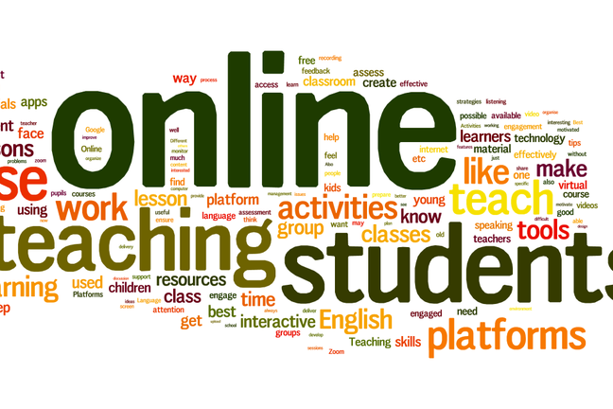
Online Tutoring
General considerations
Who are the learners for whom you’re designing or planning (age, grade, level etc)?
Where are they in their overall course of study?
Who might they rely on to help them or facilitate their learning (particularly important with young students, teens or young adults?

Slide 83
Online Tutoring
Digital literacies, connectivity, accessibility
What physical setting might they be in when engaging with you or your tutoring?
What devices or connectivity might they have access to?
How comfortable are they with the internet?
How digitally literate are they?
Have they previously learned online?
Plan remote learning that suits your learners and has been agreed with your Centre/Organisation.
Your engagement with learners will give continuity to their learning and confirm their attendance when centres reopen.

Slide 84
Literacy, numeracy and digital skills for life – working together on a new approach, NALA 2020
Literacy Now: Report examining key policy and practices in adult literacy, numeracy and digital skills in Ireland: https://www.nala.ie/publications/literacy-now/
Literacy for Life – A framework to re-examine the policy approach to supporting adults with unmet literacy, numeracy and digital issues in Ireland: https://www.nala.ie/research/literacy-for-life-2/
Literacy Impact: Research report to identify indicators to measure the outcomes of literacy strategies and initiatives in Ireland: https://www.nala.ie/publications/literacy-impact/

Slide 85
Online Tutoring
Some of the platforms used in the pandemic by tutors in the Learning Shop:
Zoom
MS Teams
Edmodo
Vscene

Slide 86
CALL Scotland
CALL: Communication, Access, Literacy & Learning
Communication and assistive technology website
Information on strategies, resources, materials, training, etc.
Supports learners with difficulties in reading/writing/numbers:
www.callscotland.org.uk/downloads

Slide 87
Useful Websites
NALA www.nala.ie
BBC Skillswise www.bbc.co.uk/teach/skillswise
Dyslexia Scotland: www.dyslexiascotland.org.uk
STEM Learning: www.stem.org.uk
CALL Scotland: www.callscotland.org.uk
Education Scotland: www.education.gov.scot
NHS Inform: www.nhsinform.scot
Future Learn: www.futurelearn.com

