Slide 1
The 21st Century Public Servant Like meercats, the 21st Century Public Servant doesn’t only focus on the current context but scans the horizon for broader issues and future challenges

Slide 2
Changing and Developing skill sets

Slide 3
Challenges & Opportunities for a CLD leader

Slide 4
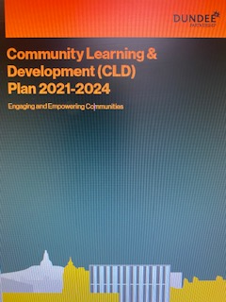
Strategic Leadership

Slide 5
Understanding and using data

Slide 6
Covid management and recovery

