Slide 1
WRITING FROM WITHIN THE CLD SECTOR
Kirsty Forrester and Sue Briggs
23rd November 2021
Karen McArdle Sue Briggs Kirsty Forrester Ed Garrett Catherine McKay

Slide 2
This presentation is about sharing experiences –
about capturing some practical thinking and activity
– it is NOT about remote expertise and ivory towers.

Slide 3
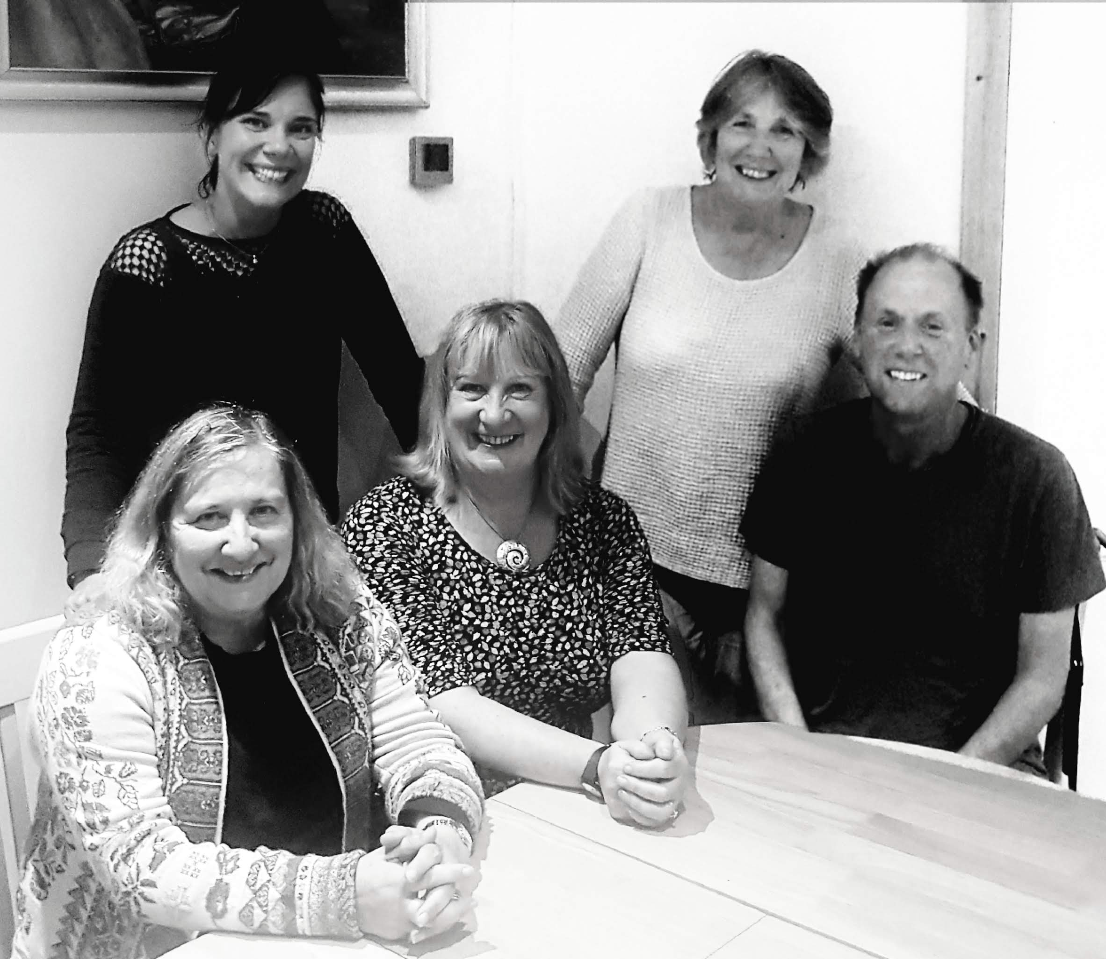
This book was about relationships…
The book was about taking time out…
The book was about learning…
The book was about tools…

Slide 4
The author / contributor view
Why write a book?
How to go about it?
Who to write with?
Will it make a difference – self?
Will it make a difference – workforce?

Slide 5
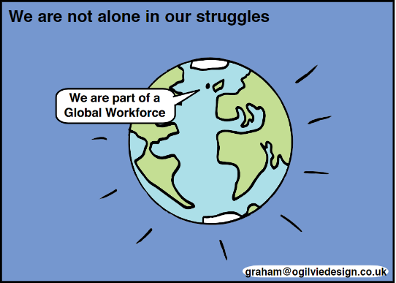
What else happened?
Resources
– challenge questions
Practitioner connections
– book club
Personal and professional development

Slide 6
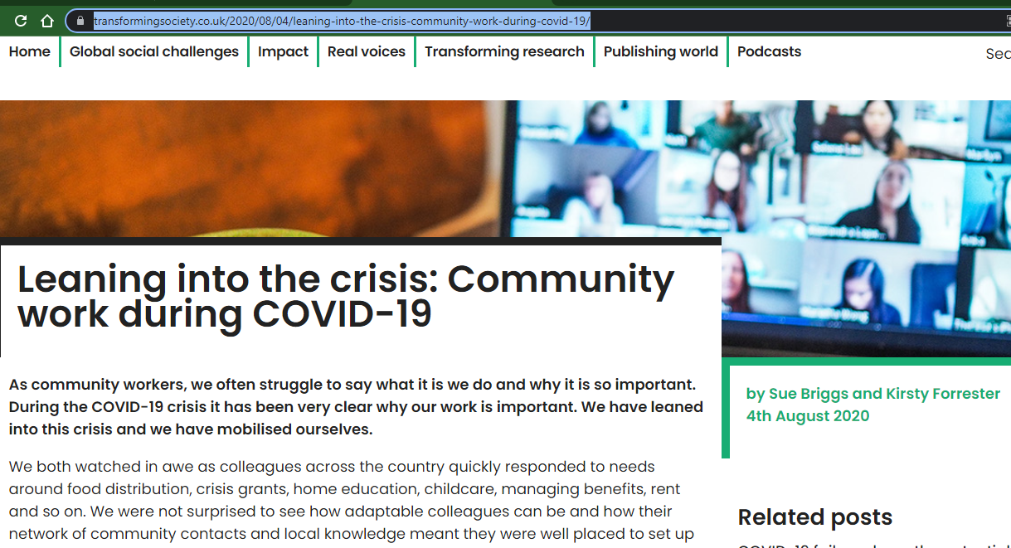
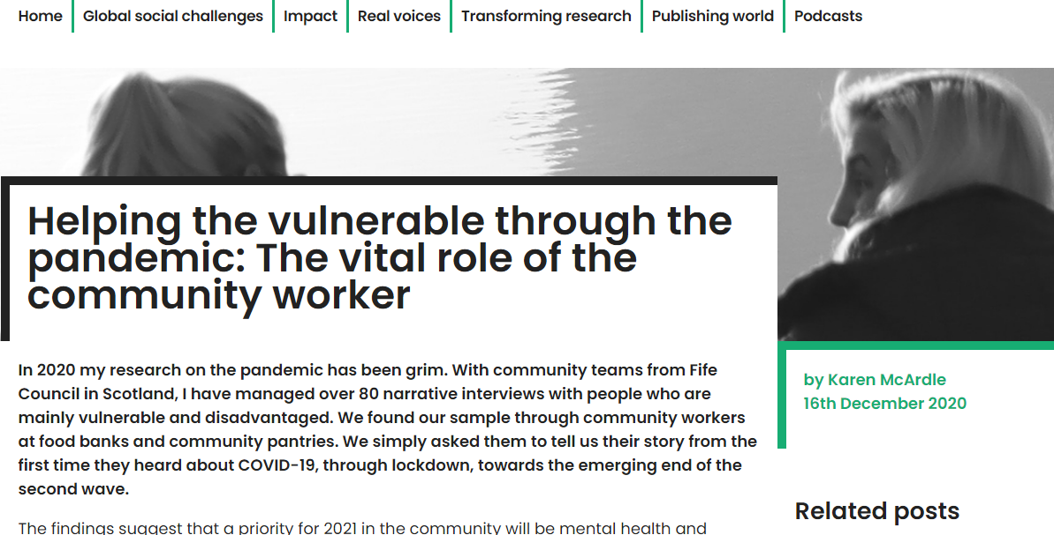
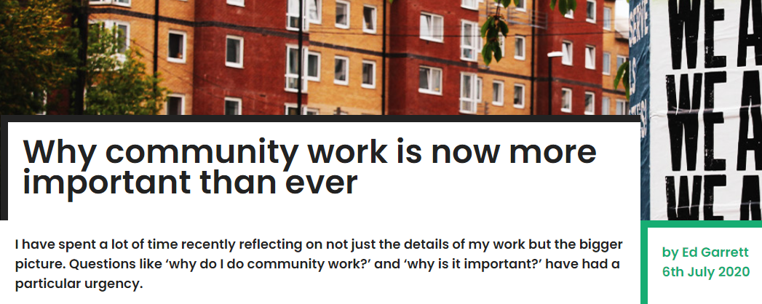
Transforming Society Blog Articles: https://www.transformingsociety.co.uk/2020/08/04/leaning-into-the-crisis-community-work-during-covid-19/

Slide 7
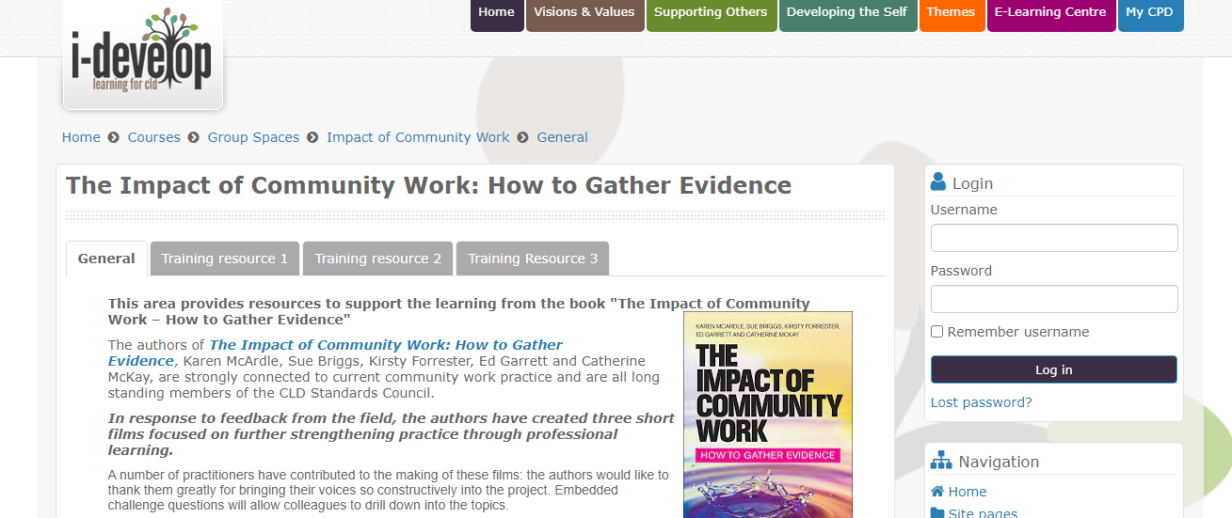
Practitioner training resources
https://www.i-develop-cld.org.uk/course/view.php?id=181&section=0

Slide 8
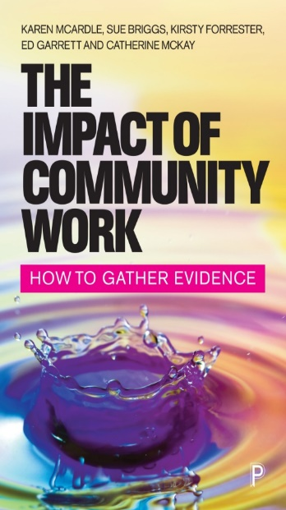
Where to now for us?
Is the world an
oyster in writing and sharing terms?

Slide 9
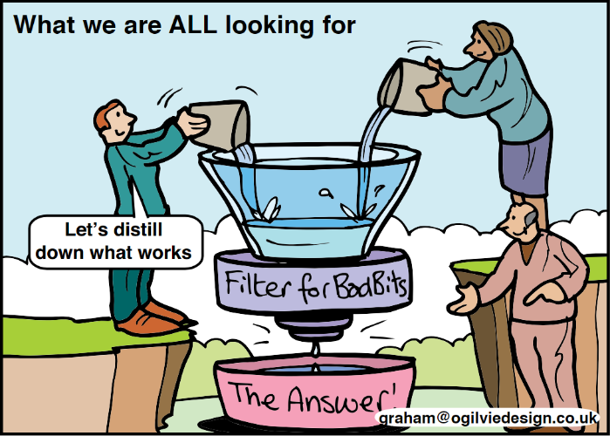
Key questions
What do you, as a practitioner, do to seek out critical dialogue?
In what ways do you share that learning?

Slide 10
Key questions…
Do we write enough from within the sector?
Is there more to be said about the impact of community work?

