Slide 1
The personal and professional – CLD and me
Maria Walker
Director of Education & Children’s Services
Aberdeenshire Council

Slide 2
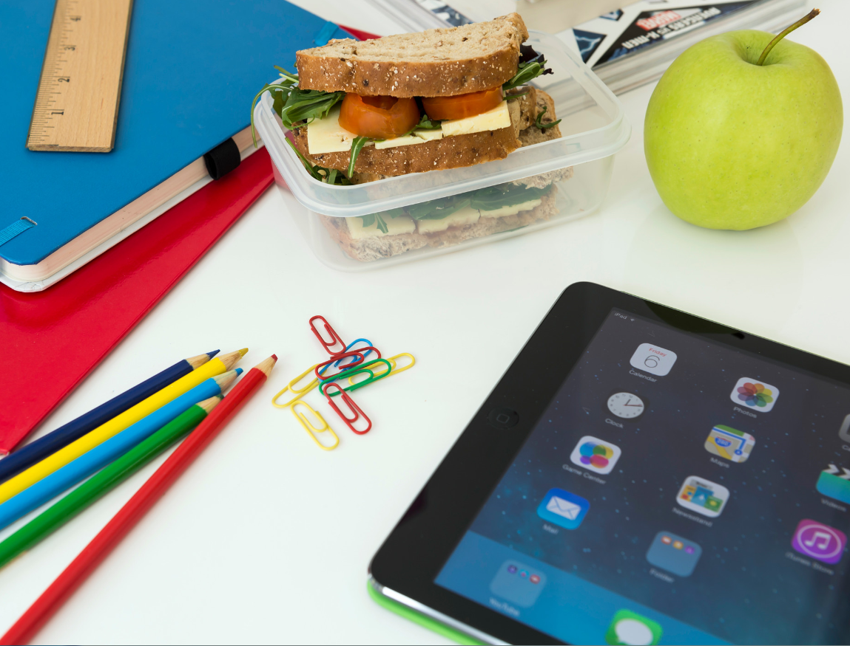
Overview
A potted personal history
The importance of our key skills and values
The journey for CLD and me
The opportunities and challenges today

Slide 3
A Potted History
Getting started
The big debates….
From a service to a part of a profession

Slide 4
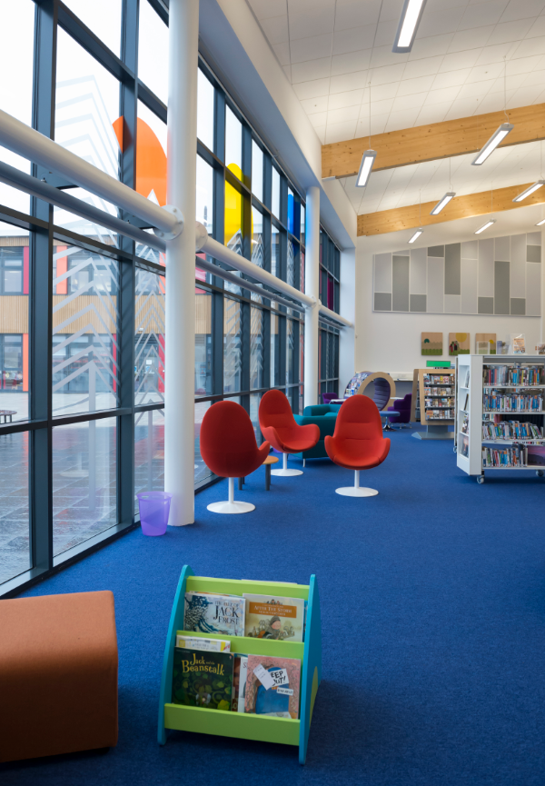
Key Skills and Valued
My Learning
flexibility
belief in the power of education and social contact
viewing leadership and management from the standpoint of an adult educator!

Slide 5
Opportunities and Challenges
In the three core areas, CLD is now needed - parental work, community engagement and work with young people
Many services don’t know how to tackle the effects of poverty and disadvantage, no matter what legislation expects
In the face of more and more cuts, it is important to hold on to professional practice, insist where your focus should be, then deliver
Don’t kid ourselves that we have all the skills and answers, we don’t.
What we have are the fishing and gluing skills- use them

Slide 6
Thank you, Good Luck and Questions
Maria Walker
Director of Education & Children’s Services
Aberdeenshire Council
aberdeenshire.gov.uk

