Slide 1
Youth work & schools partnerships programme
Part of the Scottish Attainment Challenge. Based with YouthLink Scotland
The Programme has 3 overall outcomes:
Youth work’s role and contribution to closing the poverty related attainment gap is recognised and valued
Impact of youth work to closing the poverty related attainment gap is evidenced and recognised
Sustainable, effective collaboration between youth work and formal education

Slide 2
Youth work & schools partnerships programme
Sharing good practice
Case studies
Link magazine
Learning through Lockdown
Building Capacity for Collaboration
Supporting collaboration on the ground
Youth work and schools collaborative
Sharing reflections on practice
Practical guidance and tools
Evidencing impact
National case study evaluation
Supporting joint evaluation within local collaborations
YW Ed Recovery Fund
Food insecurity pilot evaluation

Slide 3
Practical guidance and resources
Youth work guide for schools / COVID-19 Youth work and education recovery
Youth work and employability
Outdoor learning and education recovery
Collaboration for Improvement
Learning through Lockdown
National case study evaluation
Case studies
Food insecurity pilot evaluation
SEIC approach – sharing learning from April 2021
Youth work and schools collaborative
Youth Work Skills Framework
Support to youth work education recovery fund recipients
Youth work and CfE – coming soon…

Slide 4
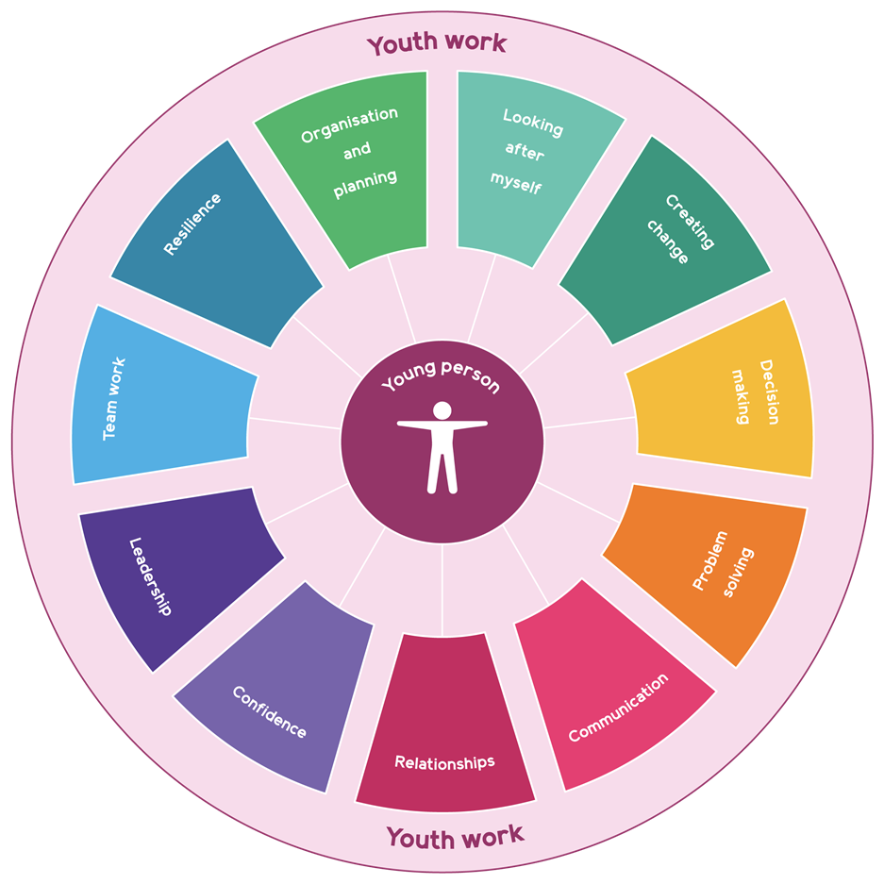
Youth Work Skills Framework
Young people develop a wide range of valuable skills in a variety of youth work contexts. These skills equip young people to live, learn and work, helping them to thrive and fulfil their potential.
The key skills that young people can develop though participation in youth work in Scotland and how these contribute to Curriculum for Excellence and the world of work.
Youth work provides opportunities for young people to develop, recognise and articulate their skills. This supports learner profiling, helping young people to profile across contexts and settings.

Slide 5
Learning through lockdown
What the sector learned during lockdown and the summer:
We – and our partners – better understand the conditions that support effective collaboration
The effectiveness of youth work as ‘first responder’ and how creative, flexible and adaptable we can be in response to the changing circumstances and needs of young people.
The value of the relationships young people build with youth workers – vital for maintaining contact with young people who would otherwise have disappeared from view
Youth work can and will support education recovery – but the support young people are looking for is not necessarily in school
New circumstances have allowed us to reach new audiences – blended learning, family engagement, working in childcare hubs and other crisis support
The resilience and creativity of our workforce – but the impact on wellbeing etc

Slide 6
National Case Study Evaluation
Reflections…
Literacy & numeracy less frequently focused on & measured – why?
25% of projects had collaborative approach to evaluation - how can we build on this?
Value when teachers and youth workers share the experience and learn together
Young people value recognition of achievement

Slide 7
Key messages and next steps
Increased recognition of youth work’s role in SAC
Increased evidence about the impact of youth work
Understanding about the types of collaboration that work best
Next steps
Continue to articulate our role as part of CfE & value of youth work for all
Continue to share good practice from community-based youth work
Create opportunities to share professional learning - to support effective collaboration in curriculum design, planning and evaluation
Use opportunities such as the YW Education Recovery Fund to model effective collaboration
Facilitate strong leadership and confident practitioners to create the conditions, structures and processes that support effective and equal collaboration

