Slide 1
Leading CLD
Dr Marion Allison
8 March 2022

Slide 2
Overview
Aim: To consider CLD professional practice.
Community Learning and Development in Scotland
The CLD Workforce
The Professionals
Values
Ethics
Competence
Attributes
Growing the Learning Culture

Slide 3
Education CLD Practice
People Life-stage
Purpose Context

Slide 4
CLD in Scotland
Policy & Legislation
Education Scotland Act 1980
The Requirements for Community Learning and Development (Scotland) Regulations 2013
Community Planning Partnerships (2001)
Community Empowerment (2015)
Ministerial Support / Portfolio
Mr Jamie Hepburn MSP, Minister for HE, FE, Youth Employment & Training

Slide 5
CLD in Scotland
Inspection Model
How Good is Our CLD 4?
CLD Standards Council
Approvals
Registration
Professional Learning
Advocacy
Funding
International Recognition
Research

Slide 6
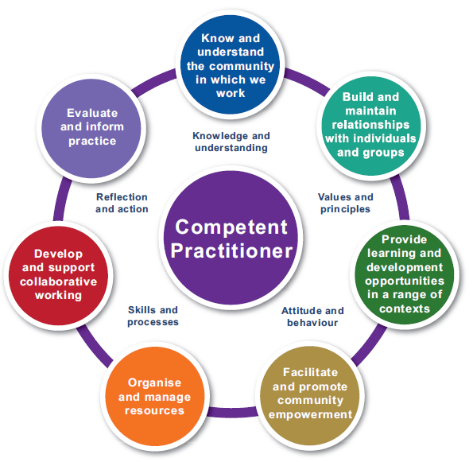
Professional CLD Practitioners

Slide 7
CLD Practise
Competences & Standards
Values
Empowerment,
Equality,
Self-determination,
Collaboration,
Lifelong Learning
Ethics supporting decision making with and for
Individual Learners / Community
Individual Practitioner / Team
Organisation / Sector influence

Slide 8
Changing World
Political
BREXIT
Independence
Community development / empowerment
Economy
Employment
Changing Work Patterns
Welfare Reform
Social
COVID-19
Demographic changes
Technological
Industry 4.0 / tech
Environmental
Climate change
Migration

Slide 9
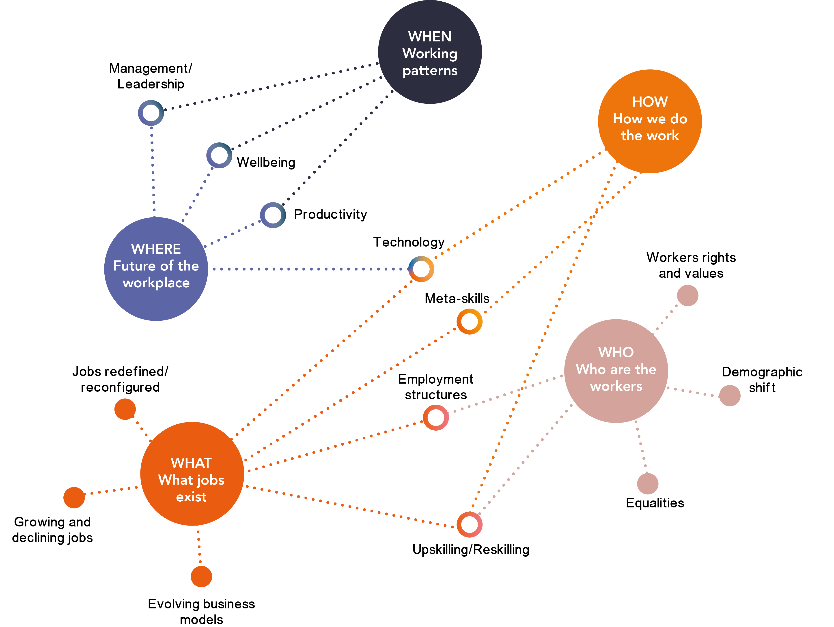
The future of work is now
Notes:
All facets of work are undergoing transformation. Due to the twin forces of the Fourth Industrial revolution and the COVID-19 recession, day-to-day digitalisation has leapt forward, with a large-scale shift to remote working and e-commerce, an acceleration in business model change and a renewed spotlight on upskilling, workers’ rights and equalities.
Future of work touches on so many. Trying to understand what the future of work is, change is happening right now.
Many have missed out, the low skilled missed out the most. Shelf life of skills reducing rapidly. Need to keep up with trends and continually upskilling and reskilling is important for all of us. Increased inequalities.

Slide 10
CLD Workforce Features
The CLD workforce is likely to experience a skills gap in upcoming years due to an ageing workforce.
The CLD sector is not ethnically diverse.
There still exists a gender pay gap in CLD, and male workers are under-represented across all CLD areas.
CLD qualifications are generally not required in third sector, but required in public sector.
Practitioners have a wide variety of training.
The CLD workforce is highly committed but stressed.
There are skill gaps including leadership and digital skills that employers are worried about meeting due to time required for training and availability of training.

Slide 11
A Code of Ethics for CLD
Knowledge & Understanding
Values & Principles
Attitudes and Behaviour
Skills & Processes
Reflection and Action
Primary Client
Social Context
Equity
Empowerment
Duty of Care
Transparency
Confidentiality
Co-operation
Professional Learning
Self-awareness
Boundaries
Self-Care
Ethical Practice - Competent Practitioners 2020 (cldstandardscouncil.org.uk)

Slide 12
Professional Practise
Consider situations you’ve been involved in or have observed – when would it have been useful to be able to reflect on recognised standards of professional behaviour for CLD practitioners?

Slide 13
Growing the Learning Culture
Self – where do you want to go, what do you need to practice / operate?
Peer – Communities of interest, mentoring, trade unions.
CLD Standards Council for Scotland | Professional Learning
Employer – Approvals, SCQF rating, partnerships, culture, policy & procedures, job titles, qualifications
Technology – Digital platforms
i-develop learning for cld (i-develop-cld.org.uk)

Slide 14
Knowledge emerges only through
invention and re-invention, through
the restless, impatient, continuing,
hopeful inquiry human beings
pursue in the world, with the world,
and with each other.”
Paulo Freire

Slide 15
Dr Marion Allison
The CLD Standards Council Scotland
The Optima
58 Robertson Street
Glasgow G2 8DU
Email: marion.allison@cldstandardscouncil.org.uk
Web: http://www.cldstandardscouncil.org.uk/
Twitter: @marionacldsc
@cldstandards
Hashtag: #BecauseOfCLD

Slide 16
Leading CLD
Dr Marion Allison
8 March 2022

