Slide 1

CLD Policy input
Scottish Government
Nicola McAndrew, Team Leader, CLD Policy Team
For Scotland's learners, with Scotland's educators
Do luchd-ionnsachaidh na h-Alba, le luchd-foghlaim Alba
Notes:
Welcome to this first module
Possible SD introduction

Slide 2


1. Which aspect of CLD are you mainly involved in? (can choose more than one)
2. What does your involvement look like in practice?
Visit www.menti.com
Use code: 3731 6207
Notes:
https://www.menti.com/qha7fz3ctu

Slide 3
Session plan
Explore some of the national policy drivers around CLD.
Look in more detail at how these might impact local strategic planning and delivery
Explore your role as CLD Leaders in policy delivery

Slide 4
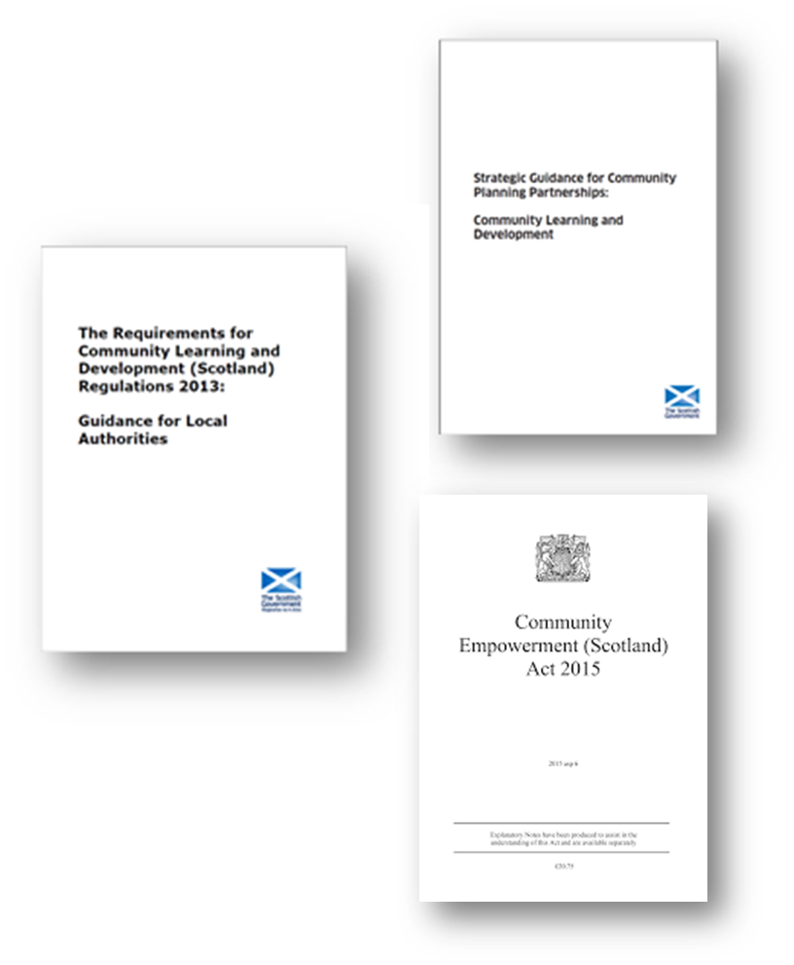

National policy and CLD
Contribution to the National Performance Framework
Specific guidance for CLD to CPPs ‘The Strategic Guidance’
The Requirements for CLD (Scotland) Regulations (the CLD Regulations)
Community Empowerment Act
Scottish Government recognises that CLD has a key role to play in reducing inequality

Slide 5
Programme for Government
“Community learning and development provides vital support to some of the most vulnerable learners to increase their skills for learning, life, and work, and can be the first step for many into further education and learning. Over the course of this Parliament, we will review the regulations for community learning and development, to ensure that they are fit for purpose, increase investment to support the sector and provide additional grant funding to increase opportunities for vulnerable learners.”
A Fairer, Greener Scotland: Programme for Government 2021-22 (www.gov.scot)

Slide 6
The CLD Regulations (2013) continue to:
Ensure communities across Scotland have access to the CLD support they need;
Strengthen coordination between the full range of CLD providers ensuring that CPPs, local authorities and other partners respond to the CLD Strategic Guidance (2012);
Reinforce the role of communities and learners in assessment, planning and evaluation of CLD, enabling them to shape provision; and
Articulate the important role and contribution of CLD and make it more visible
A review of the CLD Regulations is a Programme for Government commitment

Slide 7
The CLD regulations (2013) – What should be done
An education authority is required to publish a 3 year plan outlining:
how the education authority will co-ordinate its provision of CLD with other persons that provide CLD within the area of the education authority;
what action the education authority will take to provide CLD over the period of the plan;
that action other persons intend to take to provide CLD within the area of the education authority over the period of the plan; and
any needs for CLD that will not be met within the period of the plan.

Slide 8
The CLD Regulations (2013) – How it should be done
The process by which CLD is planned must be done in such a way which:
identifies target individuals and groups;
has regard to the needs of those target individuals and groups for that CLD;
assesses the degree to which those needs are already being met; and
identifies barriers to the adequate and efficient provision of that CLD.

Slide 9
National Policy Context for CLD and CLD Plans -
CLD Planning supports the strategic aims to reduce inequality within a local area
Some related policy areas may include:
Raising Attainment – closing the poverty related attainment gap (SAC)
Employment and Skills
Family Learning
Improving Mental Health
Community Empowerment
Tackling Child Poverty
Creating Community Wealth

Slide 10

1. How involved have you been in the development of your CLD plan?
Visit www.menti.com
Use code: 6603 3358
Notes:
https://www.menti.com/k4y9ystdne

Slide 11
Group discussion
How are the CLD regulations useful to me as a CLD Leader?

Slide 12


CLD Policy Development
Adult Literacies in Scotland 2020 (ALIS 2020), 2010
Adult Learning In Scotland – A Statement of Ambition, 2014
National Youth Work Strategy (2014 – 2019)
Community Empowerment Act – Part 2 CPPs
Adult Learning Strategy (Due Spring 2022)
Youth Work Strategy (Due Autumn 2022)
For Scotland's learners, with Scotland's educators
Notes:
This is an internal page in blue and can be duplicated to create additional pages. Always keep the heading and footer as shown. Use the corresponding blue internal and back pages if you are using this page.

Slide 13
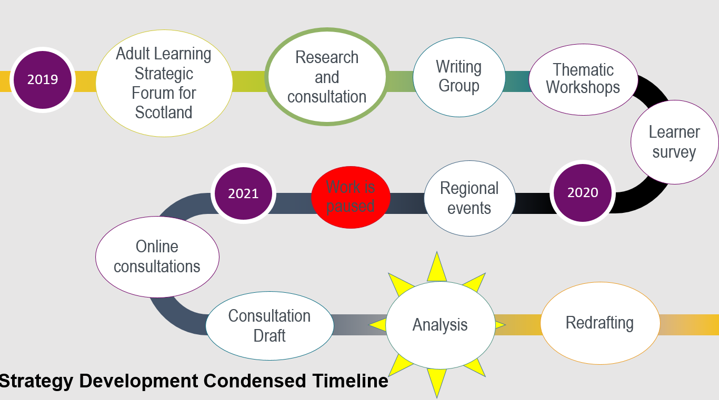
Adult Learning Strategy Development

Slide 14
Adult Learning Strategy
Key features
Guided by the Adult Learning Strategic Forum for Scotland (ALSFS).
Significant consultation with stakeholders
Focus on transforming ambition into action
Literacies and ESOL embedded throughout
4 Themes
Expanding and Extending Adult Learning
Connecting the adult learning journey
Access, Diversity and Inclusion
Workforce Development
For Scotland's learners, with Scotland's educators
Notes:
This is an internal page in blue and can be duplicated to create additional pages. Always keep the heading and footer as shown. Use the corresponding blue internal and back pages if you are using this page.

Slide 15
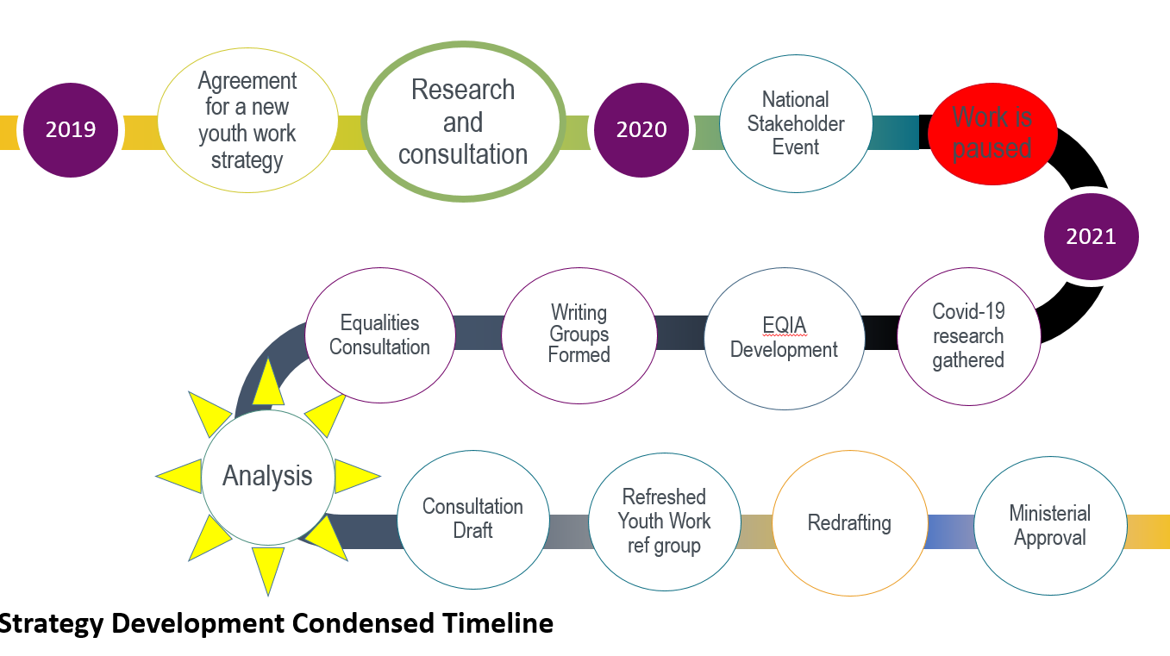
Youth Work Strategy Development

Slide 16
Draft Youth Work Strategy
Key features
Guided by the Youth Work Strategy Reference Group
Significant consultation with stakeholders
Focus on diversity and equality
Current themes
Youth work is inclusive and accessible for all
Health and well-being
Skills and achievement
Funding and investment
Workforce development
Youth work is valued, understood and communicated.
For Scotland's learners, with Scotland's educators
Notes:
This is an internal page in blue and can be duplicated to create additional pages. Always keep the heading and footer as shown. Use the corresponding blue internal and back pages if you are using this page.

Slide 17
Scottish Government Priorities
Supporting progress towards meeting our child poverty targets – is CLD currently sighted in your local plan for tackling child poverty?
Addressing climate change – How are communities involved in local planning around climate change?
Securing a stronger, fairer, greener economy – is CLD contributing to your local ambitions around employability and fair work?
For Scotland's learners, with Scotland's educators

Slide 18
Engaging with National Policy
National Agencies and organisations
Civil servants – primary relationship with local authorities is between CLD Mangers Scotland and CLD Policy Unit
Ministers – Ms Shirley-Anne Somerville, Cabinet Secretary for Education and Skills, Mr Jamie Hepburn, Minister for Higher Education and Further Education, Youth Employability and Skills

Slide 19
Breakout room discussions
1. What are the priorities for CLD in your area?
2. How do you translate policy (national or local) into practice?
3. As a leader who do you need to work with to do this?
4. What support do you need to do this?
For Scotland's learners, with Scotland's educators
Notes:
This is an internal page in blue and can be duplicated to create additional pages. Always keep the heading and footer as shown. Use the corresponding blue internal and back pages if you are using this page.

Slide 20

For Scotland's learners, with Scotland's educators
Notes:
This is an internal page in blue and can be duplicated to create additional pages. Always keep the heading and footer as shown. Use the corresponding blue internal and back pages if you are using this page.

