Slide 1
Tricia Donaghy – Inverclyde CLD
Considering working memory in CLD practice

Slide 2
Working Memory What is working memory? How does it impact on us as individuals and the individuals that we support?
Session Aims:
Have an overview of Working Memory (WM)
Awareness of the signs of WM “overload”
Awareness of Principles of WM intervention
Identify strategies to support WM
Application of above awareness and strategies to the work we do
Further reading information

Slide 3
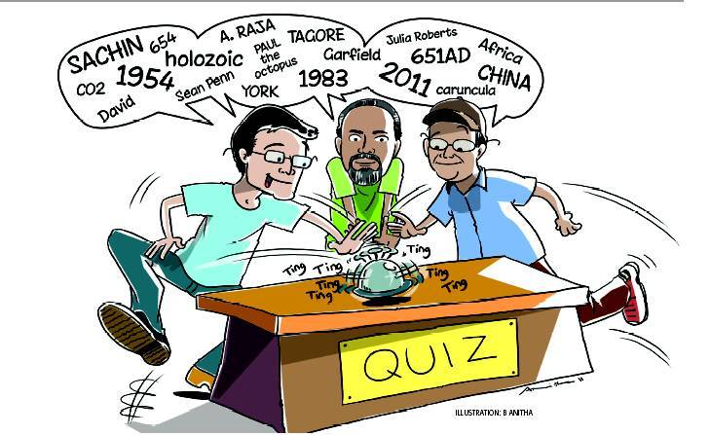
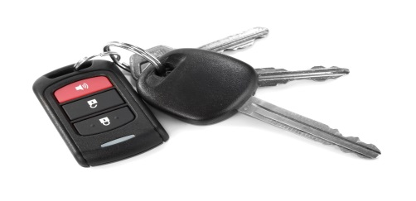
Activity 1:Memories are made of this……….
An implicit, long term memory, involved in the performance of different actions and skills e.g Riding a bike, tying your shoelaces.
Procedural Semantic
Episodic
Working
Autobiographical
When you intentionally remember something (like a Dr’s appt or friend’s birthday - an explicit memory
Episodic memory: These are your long-term memories of specific events
Overlap with episodic : Long term memories of specific events which you have personally experienced; but also involves information you have learned or discovered about your life history.

Slide 4
What is working memory: (Dr Susan Gathercole – Cognitive Psychologist https://www.youtube.com/watch?v=S65D2oazf8M

Slide 5
Working memory in action
WM – one of 11 areas of Executive Function skills
Executive Function skills – mental functions that help us plan, pay attention, remember information and perform multiple actions at the same time
Executive Function – the ‘management system of the brain’
(What is executive function? (understood.org)

Slide 6
Working memory in action – WM is an essential function in every-day life
WM:
Processes all stimuli we encounter
Delegates it to the different parts of our brain to take action
Allows us to block out unnecessary information
Keeps us updated on what’s happening – and focused on what matters
WM helps learners with:
Focusing attention
Avoiding distraction
Complex thinking
Organisation
Problem solving
Remembering tasks

Slide 7
The Common Factor
Individuals with neurodiverse conditions can have constraints on their working memory
Based on what we have just discussed, can you think of any other conditions or life experiences which may impact on an individual’s working memory

Slide 8
The Common Factor
Hormonal:
Pregnancy (“Baby brain”)
Peri-Menopause
Menopause
Old age
Approaches that take note of working memory constraints will help to meet the needs of many learners in your classes, not just those with recognised
neuro-divergencies.
Dyspraxia
Dyslexia and Dyscalculia
Autistic Spectrum Disorder
WM
Illness:
Covid
Long Covid
Brain tumour
MS
Medications
Acquired Brain Injuries:
Epilepsy
Accident
Stroke
Tourette’s
ADHD
Stress:
COVID
Family
Work
Relationship
Financial
Illness
Bereavement
WM
WM: Working Memory
Dementia/
Alzheimer's
Addictions:
Korsakoff syndrome

Slide 9
Activity :Working Memory Quiz
PART 1:
How many items of information can you hold in your working memory at any one time?
5 year old –
7 year old –
10 year old –
14 year old –
By 25 years old -
This then declines as you get older
- to !
(George Miller –Psychologist 1920)

Slide 10
Activity :Working Memory Quiz
PART 1:
How many items of information can you hold in your working memory at any one time?
5 year old – 1 thing
7 year old – 2 things
10 year old – 3 things
14 year old – 4 things
By 25 years old – 5 to 7 things
This then declines as you get older
- to 3- 4 things!
(George Miller –Psychologist 1920)

Slide 11
Activity : Working Memory Quiz
PART 2:
As adults, how much (as a percentage %) of our learning do we forget over time? (e.g. A series of 3 letter tri-grams for example, THG, XWV)
After 20 mins - 42%
After 1 hour – 56%
After 9 hours – 64%
After 1 week - 75%
Yes, without any repetitions, practical application or consolidation we will only remember 25% of what we’ve learned! (Hermann Ebbinghaus – psychologist)
“ All learning without reviewing is like
filling the bath with the plug out”
Mike Hughes (Closing the Learning Gap, 2001)

Slide 12
BREAK TIME
Important to ease Working Memory overload!
“Of all the environments humans function in, the learning environment is the most notorious for the continual overloading of working memory” Milton J Devlin 2011

Slide 13
Do you recognise this person?
Easily distracted:
- fidgeting
- getting annoyed or angry
becoming very quiet
Struggles with:
Waiting their turn
Problem solving that includes holding info in their mind
Completing tasks ,especially multiple step tasks
Finds it hard to:
Comprehend what he/she reads
Integrate new knowledge with prior knowledge
Take notes and listen at the same time

Slide 14
Effects of a working memory deficit
I DON’T KNOW HOW TO SPELL IT !!!
I CAN’T DO THIS!!!
It is extremely difficult for a learner to plan a piece of writing: construct sentences that reflect what they would like to say; punctuate work; and spell correctly.
Similar stresses may occur with formulating a verbal response to questions, coming up with solutions to problems or when trying to read something important that needs your full understanding and appropriate response in a very short space of time.

Slide 15
The principles of WM intervention
To “avoid working memory failures in order to prevent learning from being delayed or impaired”
(Gathercole &Alloway 2008)
What are the 8 principles? (discuss and feedback)
Recognise
Monitor
Evaluate
Reduce
Be aware of processing demands
Repeat
Teach memory aids
Teach metacognition (how you learn)

Slide 16
How to remember the principles – a useful strategy
Mneumonic for the principles
R E M B A R TT (Mc and Ma)
“REMemBA , Reduce Teaching (Meta Cognition and Memory Aids)
Or
REMBaRT Mc n Ma
Recognise, Evaluate, Monitor, Be Aware, Reduce,
Teach – Meta cognition and Memory Aids

Slide 17
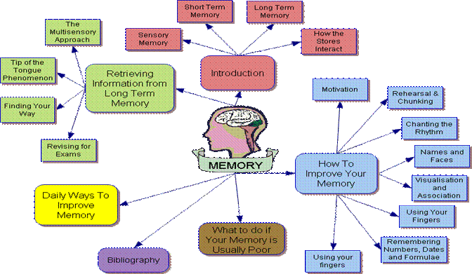
Working memory strategies
RHYTHM
R- Rhythm
H – Has
Y – Your
T- Two
H- Hands
M – Moving
Mnemonics
Mindmaps

Slide 18
Group activity – learner scenario
Jane has been attending an employability work club for several weeks. Today she has asked for support to complete an application form with an imminent deadline as advised by her DWP Work Coach. For this application, Jane needs to register with an employment website and then upload her CV. Jane needs to update her CV to include her last employment details before she can upload it. The tutor is providing verbal step-by-step instructions to Jane but Jane is struggling to remember each step and is now quite frustrated and is considering not applying for the position.

Slide 19
Group activity: What would you do?
Please discuss the scenario and answer these questions:-
What are the possible WM demands of the learning activity?
Which signs of WM overload is the learner exhibiting?
Based on the principles of WM interventions - what support would you offer to a learner with limited working memory?

Slide 20
Reflective Practice
Think of a learning activity within one of your groups and the learners you work with and answer these questions:-
What are the WM demands of your learning activity?
Which signs of WM overload may your learners be exhibiting?
Based on the principles of WM interventions - what support would you offer to a learner with limited working memory?

