Slide 1
Participation and inequalities CLD practitioners as democratic innovators?
Dr Oliver Escobar
Lecturer in Public Policy, University of Edinburgh
Co-Director, What Works Scotland
Notes:
What Works Scotland’s remit is: Using evidence to transform public services for all of Scotland’s communities to flourish
Our work is guided by the key principles from the Christie Commission

Slide 2
Notes:
hat Works Scotland’s remit is: Using evidence to transform public services for all of Scotland’s communities to flourish
Our work is guided by the key principles from the Christie Commission

Slide 3
Inequalities
central in the current policy agenda in Scotland, UK and beyond

Slide 4
influencial research evidence, best sellers

Slide 5
Relationship between
citizen participation / community engagement
And inequalities

Slide 6
Inequalities in health, income, wealth, education…
stemming from inequalities of power and influence?

Slide 7
a critical approach to participation
International context –ideology of participation & consultation has spread through public, private and third sectors
Calhoun (2015): “the paradox of growing participation and declining democracy”
A more ‘participatory social style’ but not a more participatory democracy
Walker, McQuarrie & Lee (2015): the paradox of growing participation and growing inequalities (influence, health, economic)
De-politisation of public participation?
‘extractive’ nature of the consultation industry > market research, not democracy
‘designer democracy’ > ad hoc designs, not part of the democratic system
tools for ‘community engagement’ rather than processes for ‘social transformation’?
Lack of EMPOWERED + DELIBERATIVE participation?
Notes:
A more ‘participatory social style’: citizens are invited to endorse their favourite products and engage with companies; add their voice to the echo chambers of the social media; take part in pre-framed consultations; participate in myriad polls, surveys, popularity contexts…

Slide 8
The evolving role of citizens
Decision makers face increasing challenges + complexity of social problems and policy work – who can help?
Narrative of decline (Dalton; Putnam):
Declining trust (+ legitimacy) in public institutions; levels of turnout in elections; social capital
Narrative of progress (Norris):
In the last 50 years citizens have become better educated, more critical, less deferential…
Yet… the role of the citizen in policy and political life remains thin – we have built a ‘democracy of intermediaries’
What kind of citizen are citizens invited to be?
Spectators, bystanders, complainers, protesters, voters
Or deliberative participants, co-producers and decision makers

Slide 9
In participatory democracy…
“…citizens govern themselves directly, not necessarily at every level and in every instance, but frequently enough and in particular when basic policies are being decided and when significant power is being deployed.
This is carried out through institutions designed to facilitate ongoing civic participation in agenda-setting, deliberation, legislation, and policy implementation…”
Benjamin R. Barber, Strong democracy, 1984
Notes:
To be clear, PD can work in tandem with Representative Democracy, and actually many argue that they can strengthen each other

Slide 10
Towards deliberative democracy
Narrative of partisan participation
Emphasis on mobilising the like-minded + Problem of uninformed participation
Narrative of deliberative participation
Emphasis on diversity and difference + Quality of communication and interaction + informed participation
‘deliberative democracy’ is based on the idea that decision-making should be based on reasoned public debate, where no force other than that of the better argument should prevail (Habermas 1975)

Slide 11
Deliberative democracy
Deliberative democrats argue that democracy
should be more than ‘counting heads’: “it must involve discussion on an equal and inclusive basis, which deepens participants’ knowledge of issues, awareness of the interests of others, and the confidence to play an active part in public affairs” (Saward 2000:5).
should not be conceived as a market for the negotiation of private preferences and interests, but as a forum for forming public-spirited reasons in order to reach collective agreements (Parkinson, 2004: 379).
The goal of public deliberation is …“to improve the legitimacy of democracy by making democratic institutions systematically responsive to reasons, not just the weight of numbers or the power of interests” (Parkinson 2012:170)

Slide 12
In the last 3 months, have you participated in a public forum to discuss policy or community issues?

Slide 13
Stay standing if at that forum there was a reasonable…
…gender balance
…mix of personal and professional backgrounds
…range of perspectives and opinions
…age range (i.e. 3 generations)
…sense that most participants felt included and influential
…sense that most participants enjoyed it
… sense that their participation would have a clear impact

Slide 14
Key challenges in organising community engagement processes
Inclusion and diversity
Quality of dialogue and deliberation
Impact: clear link to policy and decision making

Slide 15
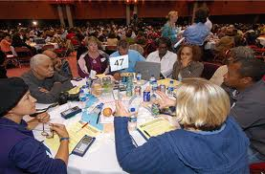
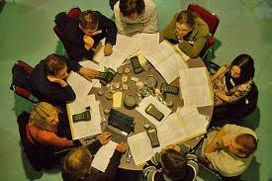
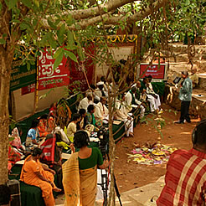
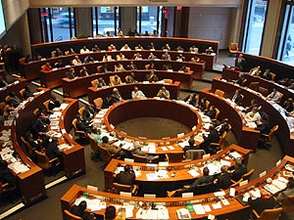
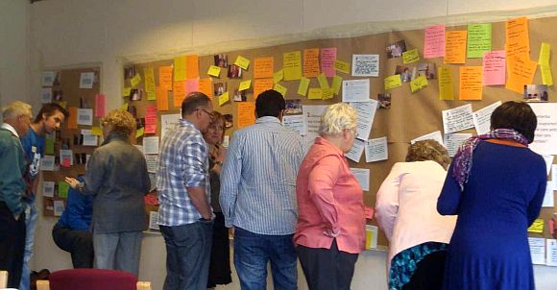
The growing field of Democratic Innovation:
Building institutions for
participatory and deliberative democracy
See www.participedia.org
Notes:
15
There are hundreds of democratic innovations developed in the last 3 decades around the world. See www.participedia.org
Here I use 2 examples, focussed on face-to-face participation, although there are also numerous innovations in digital participation.
Examples:
-PB in Paris: “between 2014 and 2020, we will have allocated a total of 500 million Euros to projects imagined and chosen by the public”. Pauline Véron, Deputy Mayor of Paris in charge of local democracy, citizen participation, NGOs, youth and employment.
-Mini-public in Ireland: In 2014 Citizens Assembly, and 2015 referendum

Slide 16
Participatory Budgeting : Outcomes in Porto Alegre Baiocchi 2001, 2005; Sintomer et al. 2012; Wampler 2014
Increased new housing for poor families > 1986-1988=1,714 families; 1992-1995=28,862 families
Higher expenditure on health; measurable reduction on indicators of health inequalities over 25 years (e.g. infant mortality)
Increased number of schools and nurseries > 86 schools in 2001 (vs. 29 in 1988)
Improved infrastructure
20 Km of new pavement yearly in poorest areas
98% residents have running water (vs. 75% in 1988)
Reduced spending in administrative costs and improved relationships between residents and officials
Increased citizen participation
Peak in 2002: 17,200 participants + Specially by disadvantaged groups
Shift of public investment to tackle health and social inequalities
Notes:
Between 9 and 21% of capital expenditure allocated through PB in Porto Alegre

Slide 17
The Paris example
“between 2014 and 2020, we will have allocated a total of 500 million Euros to projects imagined and chosen by the public”.
Pauline Véron, Deputy Mayor of Paris in charge of local democracy, citizen participation, NGOs, youth and employment.
Notes:
PB in Paris: “between 2014 and 2020, we will have allocated a total of 500 million Euros to projects imagined and chosen by the public”. Pauline Véron, Deputy Mayor of Paris in charge of local democracy, citizen participation, NGOs, youth and employment.

Slide 18
Mini-publics
A ‘mini-public’ is a deliberative forum where a group of citizens (12-500) are:
selected randomly to reflect the diversity of the public affected by the issue,
given a task (e.g. setting priorities, reviewing services, producing plans, judging competing evidence)
and given time and support to develop considered opinions and judgements.
Equalities emphasis
Measures in place to lower barriers to participation and minimise self-selection bias (E.g. stipend, random selection, support)
It generates decisions or recommendations that authorities must respond to, and which inform broader community engagement / public deliberation

Slide 19
The Melbourne example
Members of the Citizens’ Jury at the Melbourne City Council
43 citizens (selected by lot), 10 year financial plan, 5 billion dollars
Notes:
43 citizens, 10 year financial plan, 5 billion dollars

Slide 20
Participation and Equalities – the Irish example
Irish citizen-led Constitutional Convention 2014
Image from: http://politicalreform.ie/2014/02/26/the-irish-constitutional-convention-completes-its-work/
Crowds at Dublin Castle celebrate the signing of the Marriage Equality Act 2015
Image from: http://www.newstalk.com/President-Higgins-signs-Marriage-Equality-Act-into-law

Slide 21
Recent report- Involving communities in deliberation: A study of 3 citizens’ juries …
http://tinyurl.com/citizens-juries

Slide 22
What does this mean
for CLD practice?

Slide 23
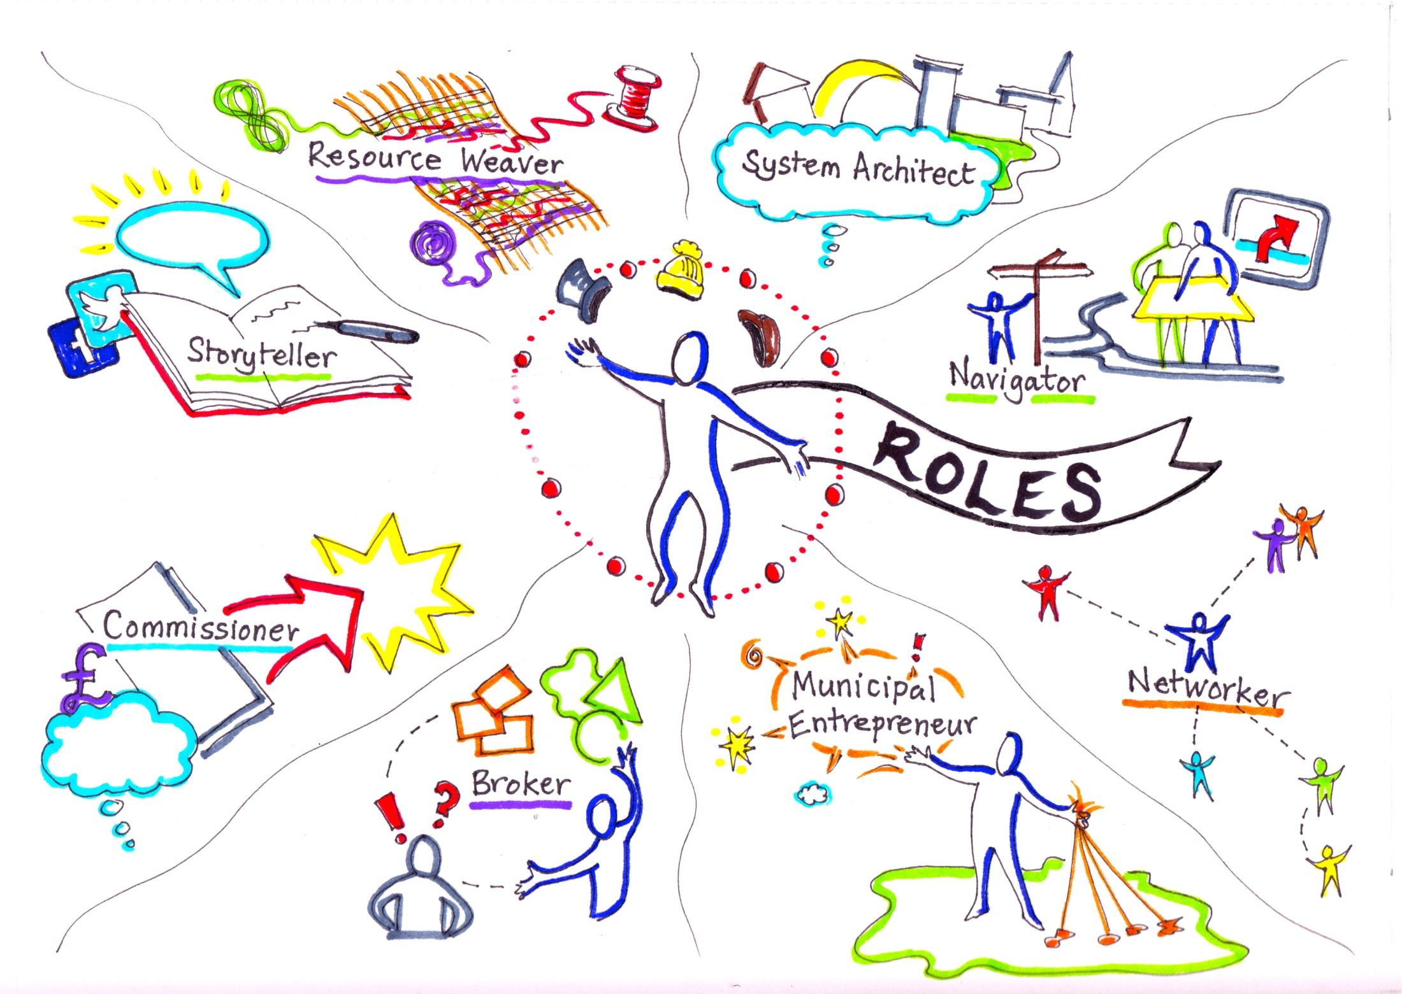
Notes:
Slide replicated from work by Catherine Mangan, Catherine Needham and Helen Dickinson (University of Birmingham) –Project: The Twenty-first Century Public Servant/

Slide 24
CLD practitioners as democratic innovators? A job description
Knowing how to develop and perform democratic publics and processes (variety of skills, techniques, formats)
Prowess in backstage and frontstage political work
negotiating, nudging, nagging, cajoling, pressing, persuading, reframing, aligning, trapping, enticing, enthusing, concealing, disclosing, unleashing, connecting …
Ability to act as conflict resolution mediators
Ability to facilitate dialogue and/or deliberation (e.g. creative consensus, productive disensus)
Ability to reflect for, in and on action
Ability to build relational capital and strike unlikely alliances
Knowledge-brokering and network-building skills
In-depth local and political knowledge

Slide 25
Concluding thoughts
Scottish approach: international evidence + local knowledge = home-grown democratic innovation
Understanding how participatory, deliberative and representative democracy coalesce or collide > Need for institutional reforms as well as ‘culture change’?
Capacity building: facilitation, mediation, negotiation and process design skills + Collaborative, creative, facilitative leadership
EMPOWERED and DELIBERATIVE? Caution about piecemeal approaches, i.e. ‘ad hoc’ community engagement ‘tools’ rather than new processes coherently connected to the democratic system
Funding: resource-intensive, but
High-stakes community issues
Quality over quantity
Notes:
How much would you pay for effective democracy / decision-making?

Slide 26
What Works Scotland http://whatworksscotland.ac.uk Get in touch: oliver.escobar@ed.ac.uk
Thank you!

Slide 27
Notes:
hat Works Scotland’s remit is: Using evidence to transform public services for all of Scotland’s communities to flourish
Our work is guided by the key principles from the Christie Commission

