Slide 1
Learning Lunch Group Exercise How Good is the Learning and Development in our Community?
KIRSTY ANDERSON
Policy Adviser
Community Planning & Partnerships

Slide 2
Competences for Community Learning and Development
Notes:
CLD Regulations 2013 (addendum to Education Act) define community learning and development as ‘programmes of learning and activities designed to promote the educational and social development of target individuals and groups.’
common defining feature is that programmes and activities are developed in dialogue with communities and participants with the aim of helping them tackle real issues in their lives through community action and community-based learning.
Learning Lunches promote the 7 competences of the CLD standards council – sector body – but these are fairly generic competences mirrored by many other sectors. CLD does have a strong focus on empowerment however. Today we are focusing on ‘facilitate and promote community empowerment’
Also values defined by sector body that underpin these.
Values
Self-determination - respecting the individual and valuing the right of people to make their own choices.
Inclusion - valuing equality of both opportunity and outcome, and challenging discriminatory practice.
Empowerment - increasing the ability of individuals and groups to influence issues that affect them and their communities through individual and/or collective action.
Working collaboratively – maximising collaborative working relationships with the many agencies which contribute to CLD and/or which CLD contributes to, including collaborative work with participants, learners and communities.
Promotion of learning as a lifelong activity – ensuring that individuals are aware of a range of learning opportunities and are able to access relevant options at any stage of their life

Slide 3
Learning Lunch Objectives
Demonstrate increased knowledge and understanding of the new evaluation framework for CLD – How Good is the Learning and Development in our Community?
Demonstrate increased skills/competences in evaluating and informing practice.
Utilise increased networks with colleagues within the Council and external partners.
Further ensure CLD activity is focussed and high quality.
Notes:
Objectives for today’s Learning Lunch

Slide 4
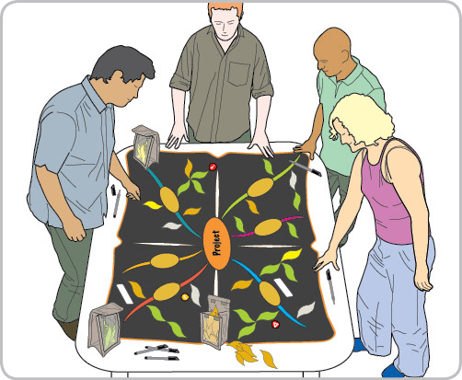
What is Ketso?
Ketso means ‘action’ in Lesotho, where it was invented.
Ketso offers a structured way to run a workshop, using re-useable coloured shapes
Enables people to build up visual picture of discussion and see ideas taking shape.
Notes:
It’s also Fun
Developed by Dr Joanne Tippett (Lecturer in spatial planning, Manchester university as dissertation topic – made action plan to succesfully help an African community overcome their environmental challenges. Refined over 2 decades of action research with communities across the globe.
Explain central trunk branches and leaves – builds on positives / assets (research proven to be best start).

Slide 5
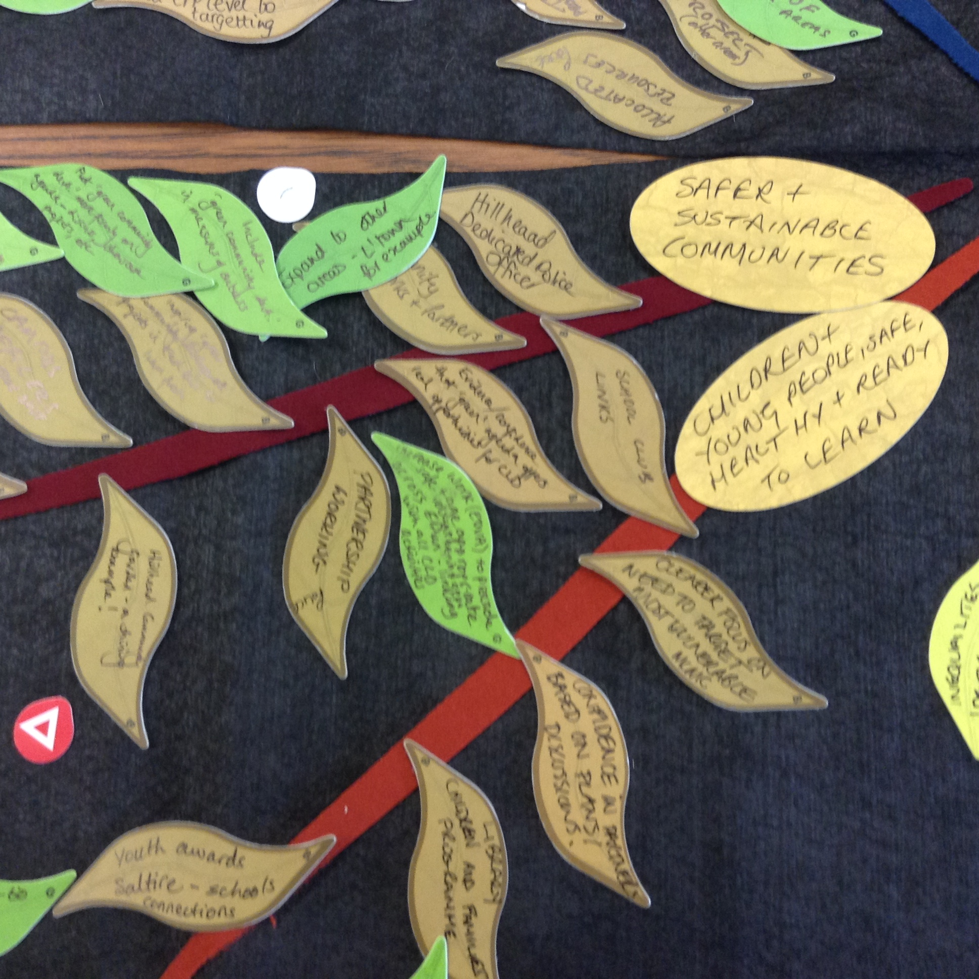
Why use Ketso?
Everyone’s voice is included – can be used with vulnerable clients or equality groups
Can help to meet requirements of SOA, CE Act, Equalities Act, CLD Regs – developing services / making policy WITH communities and not FOR them
Can be used in a variety of settings e.g. planning, researching, policy development, reporting and evaluation.
Notes:
Public Sector Equality Duty requires all public sector bodies to involve those affected by your policy or service in the design or formulation of that policy or service (wording reflected in our SOA).
CLD plan – need right branches and right people in the room.
Used by 50% UK Universities (demonstrates research impact) – used in 42 countries.
Good for bottoming out complex issues as it is multi-layered. Engaging people helps them learn / take ownership.
Need to be careful to respect the science of Ketso – has been subject to 20 years action research which has proven it to be effective – but that relies on getting it right. Need to have right people in the room, correct branches and also then be prepared to take forward the actions people outline. If this is about policy it is therefore really important that you give people some context (eg research and stats) so that they don’t just come out with a lot of things that are entirely unachievable. Fact it is built on assets and positives does help to overcome that though.

Slide 6
CLD Values
The CLD Standards Council has set the following values for CLD that have been adopted in the plan:
Self-determination
Inclusion
Empowerment
Working collaboratively
Promotion of learning as a lifelong activity
Notes:
Self-determination - respecting the individual and valuing the right of people to make their own choices.
Inclusion - valuing equality of both opportunity and outcome, and challenging discriminatory practice.
Empowerment - increasing the ability of individuals and groups to influence issues that affect them and their communities through individual and/ or collective action.
Working collaboratively – maximising collaborative working relationships with the many agencies which contribute to CLD and/or which CLD contributes to, including collaborative work with participants, learners and communities.
Promotion of learning as a lifelong activity – ensuring that individuals are aware of a range of learning opportunities and are able to access relevant options at any stage of their life

Slide 7
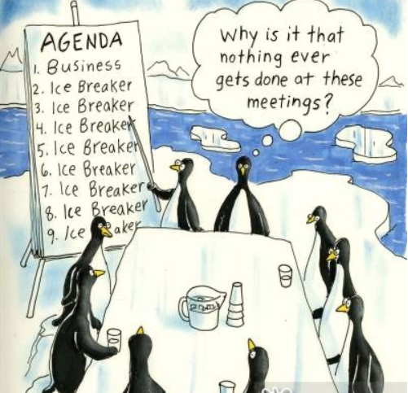
Icebreaker

Slide 8
Ketso Branches and Leaves
Notes:
RETURN TO SLIDE 3 and do TRIAL EXERCISE
Two ways of using rest of the session – you can either pick the subject of your ketso session or we can do one relevant to all that I pick (what makes successful partnerships).
Take 2 minutes to think of a plan, some research, a report, policy, event or evaluation that you need to do that involves our community.
Write the item down and take turns to place on the mat / explain your item
Everyone votes on which item they would like to discuss in more depth – place ticks
That item becomes the Ketso discussion – write it on a big centre piece
Break down the topic into the key themes or chunks – write these as branches
Once you have five or so branches start putting brown leaves on branches – take it in turns.
Successful partnerships branches –ask people what are the key things that make up a successful partnership – write on flip chart
Process and procedure
Culture and assumptions
Communication and info
Action and responsibility
Aims and purpose

Slide 9
Thanks for Coming!
CPP Team happy to lend out the Ketso kit to assist with your community engagement (guide included)
Will send powerpoints, pictures and write-up of your work on a spread-sheet - templates available from www.ketso.com)
Free training by University of Glasgow
Please complete your evaluation form!
Notes:
Next Learning Lunch end September – will be a programme for the year with at least one per month circulated by end of August from CPP Team.

